Slide 1
Applied Fieldwork Enquiry
1. Geographical Questions

Slide 2

The six stages of the enquiry process
Ask questions
Collect data
Process & present data
Draw conclusions
Evaluate the process
Analysis and application of wider understanding

Slide 3
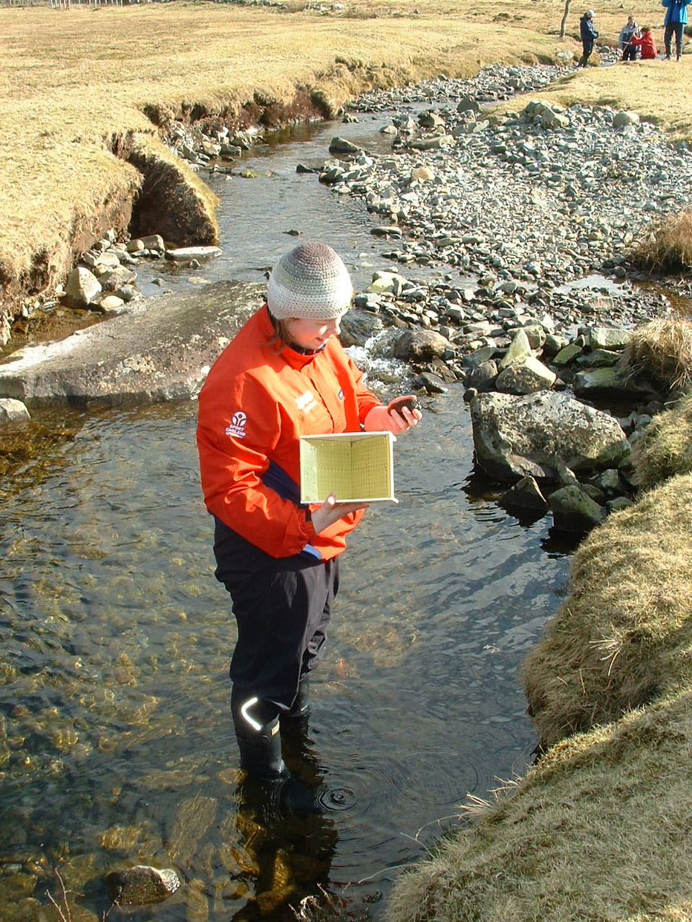
What is the geographical enquiry process?
This involves asking questions about geographical processes or concepts.
It includes:
questioning spatial patterns (e.g. urban land uses, flood risk, vegetation on a sand dune)
geographical processes/ change (e.g. urban regeneration, river or coastal processes)
testing hypotheses
© 2017 Snowdonia National Park Authority SNPA

Slide 4

Choosing a question
Why have all these shops closed down?
What’s happening here?
Why is it so windy here?
What can I do?
How has that been formed?
Why is it like this?
Is the landscape being damaged?
Why are there so many people here?
Be curious!

Slide 5
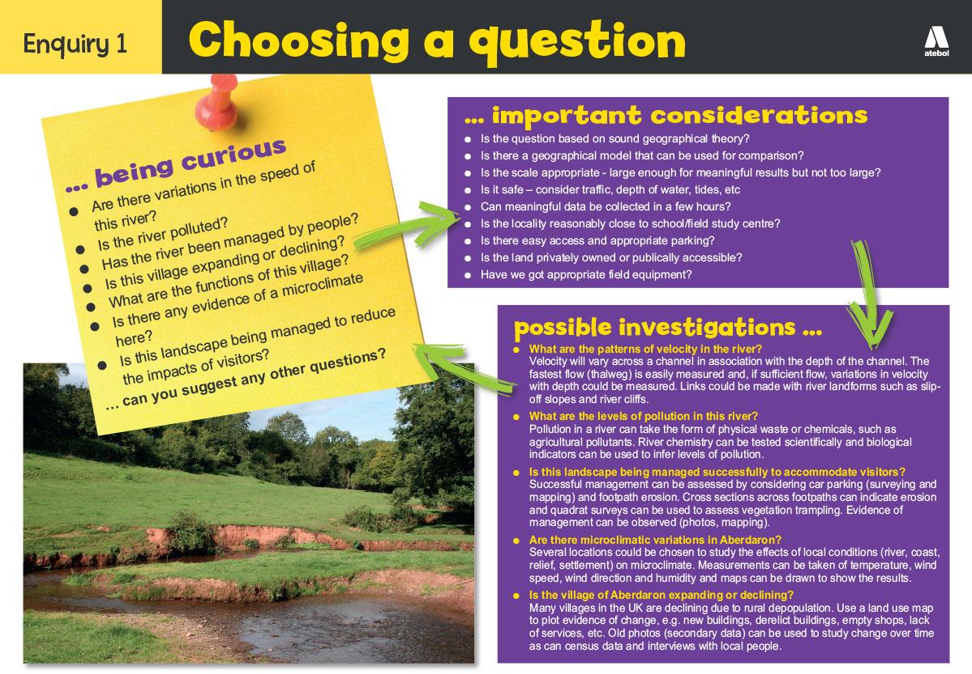
Be curious – take a look

Slide 6
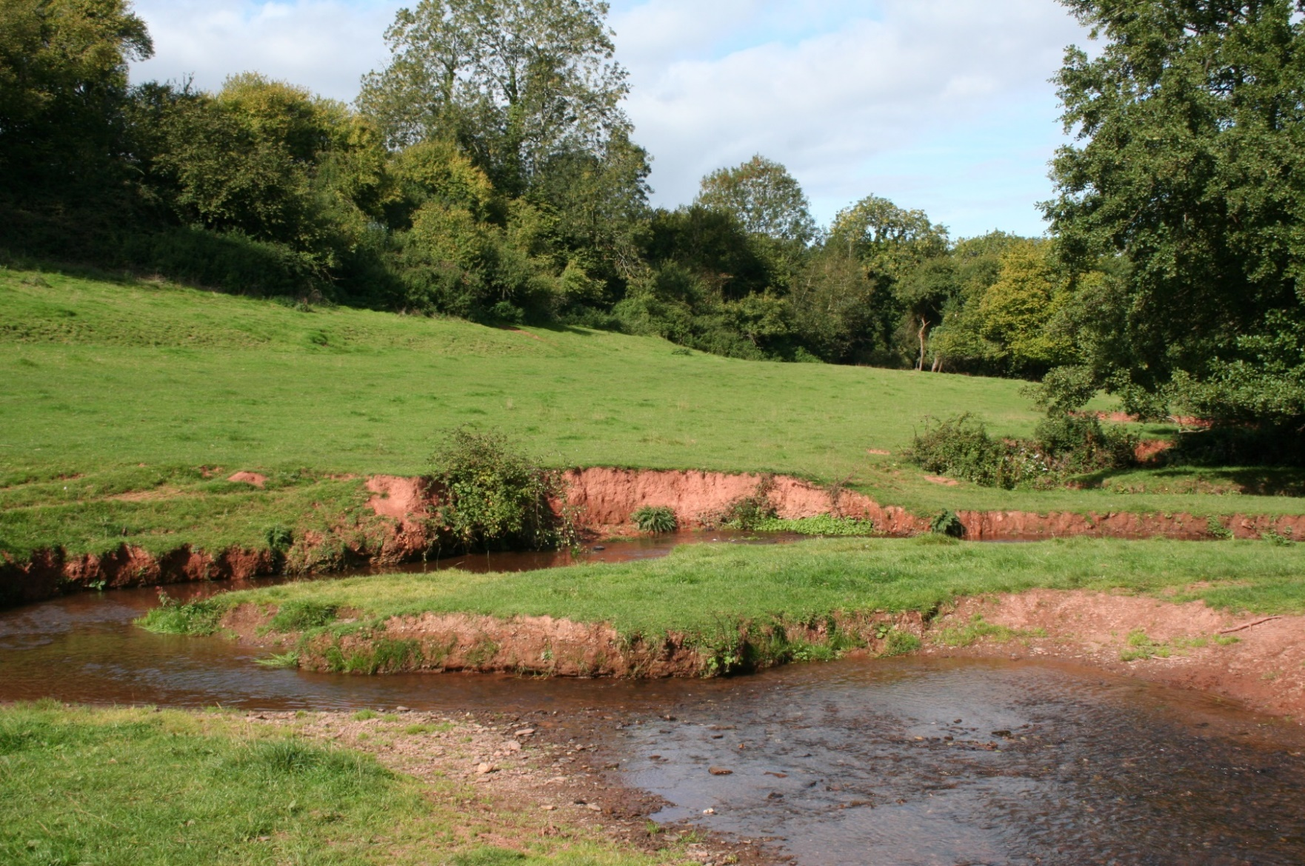
Rivers – what questions can be asked?

Slide 7
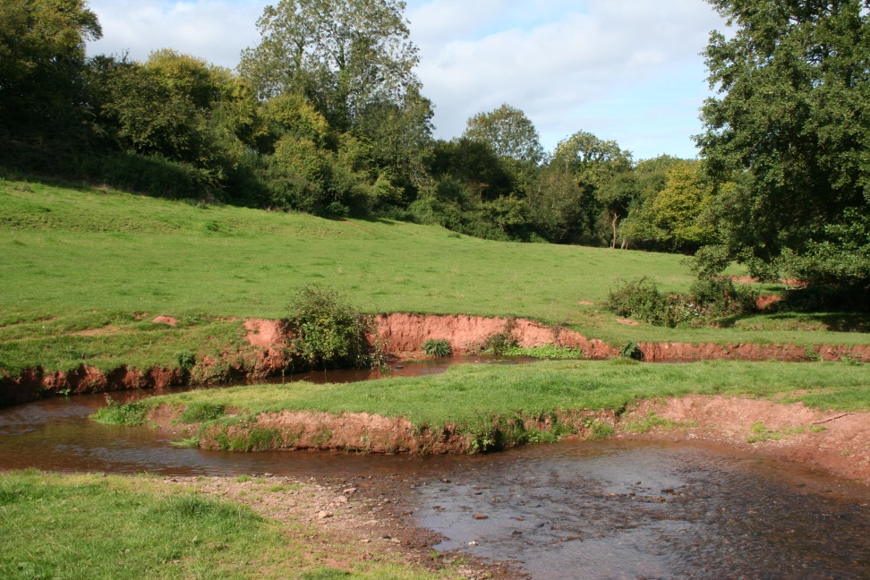
Rivers – what questions can be asked?
What are the river landforms?
What river processes are operating?
How is the surrounding land used by people?
How do human activities affect the river processes and landforms?
Does the river flood?
What are the characteristics of the river meander?

Slide 8
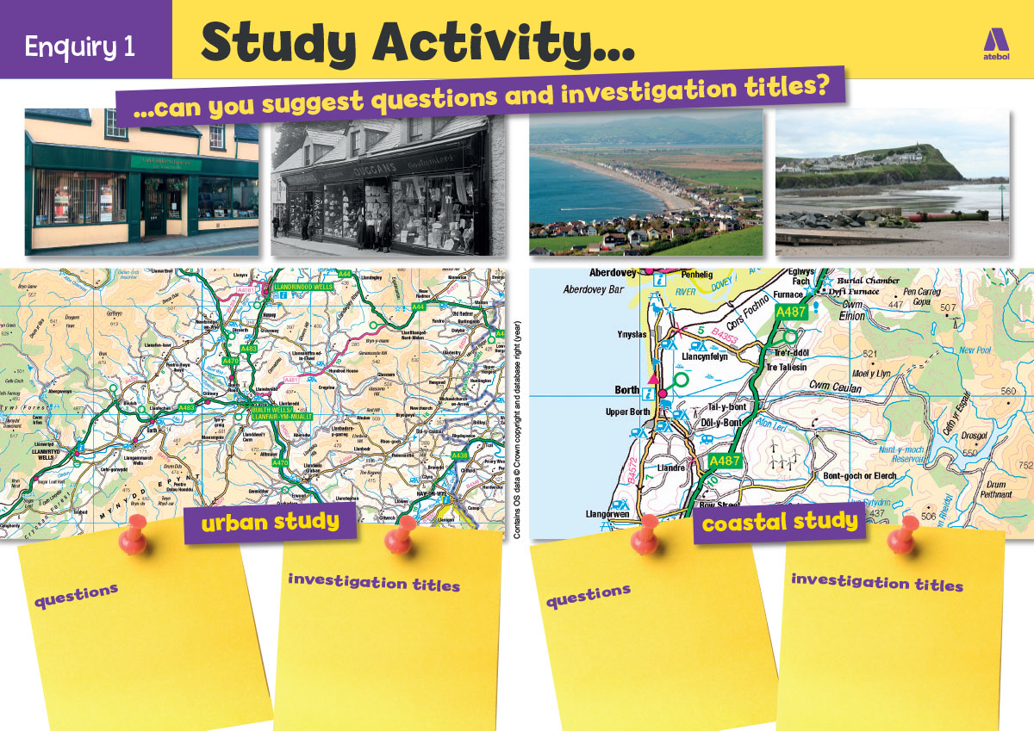
Now have a go yourself!
Suggest questions for the urban and coastal study

Slide 9
Possible questions
Urban
What changes have taken place in the town?
What are the main functions in Builth Wells?
Is there a clearly demarked central area?
Is there a risk of river flooding in the town?
What is the town’s sphere of influence?
Coasts
What is the evidence of longshore drift?
How has coastal management affected processes and landforms?
How does sediment change along the beach?
Does the beach profile change with distance along the beach?

Slide 10
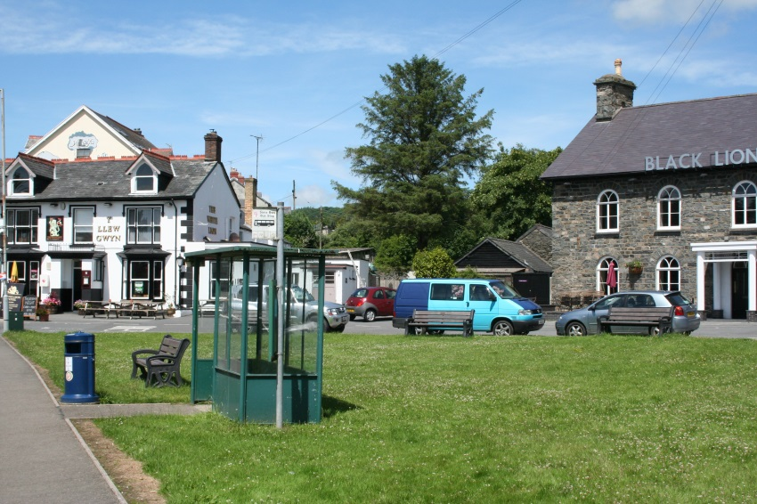
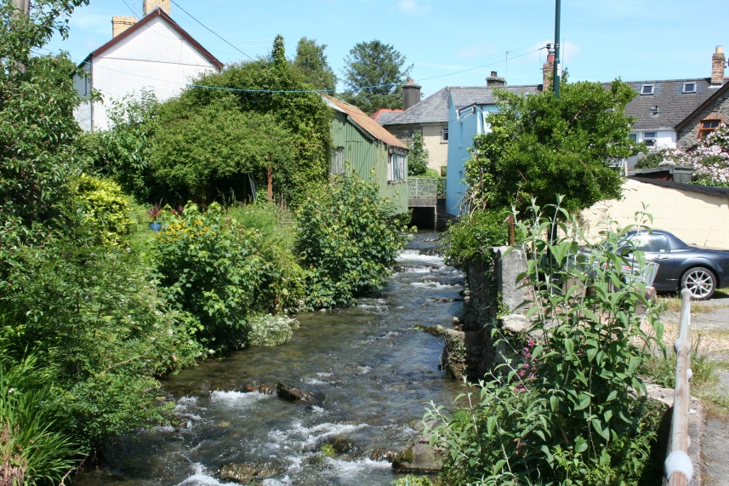
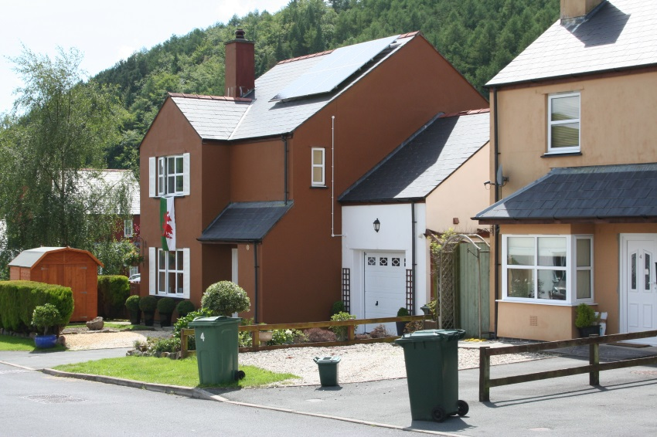
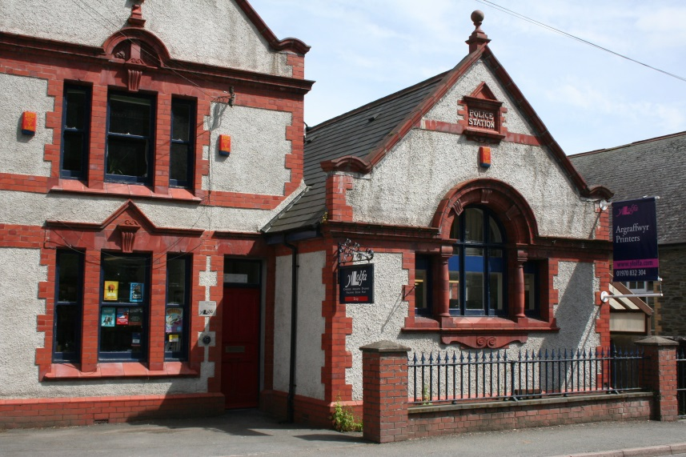
Rural settlements – what questions can be asked?

Slide 11
Rural settlements – what questions can be asked?
What is the evidence of change?
Is the village a commuter village?
What are the environmental issues?
Is there a risk of flooding?
Is the village growing or declining?

Slide 12
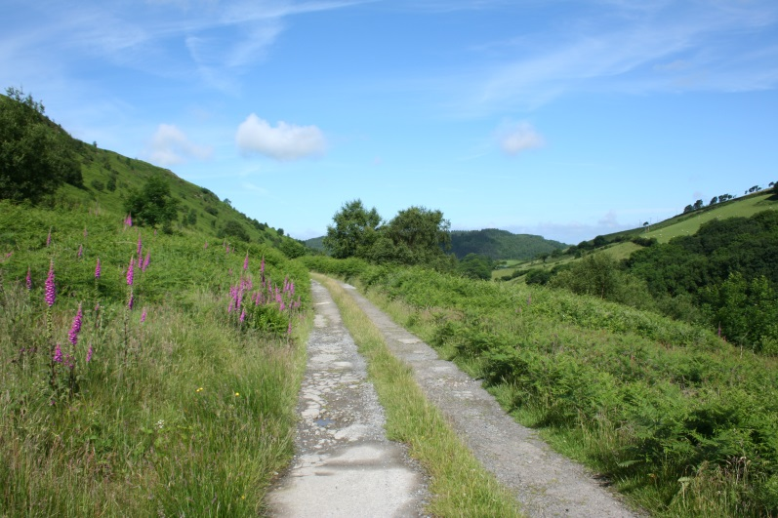
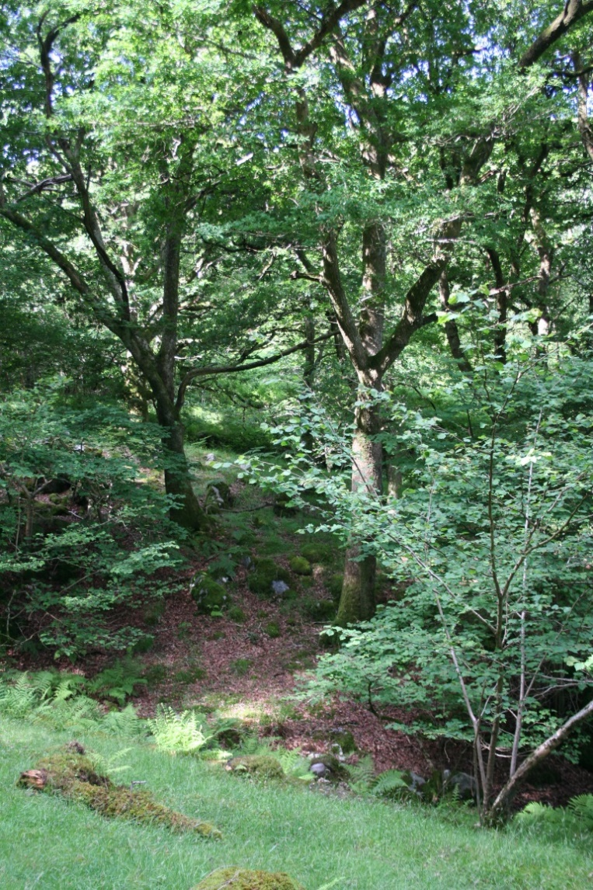
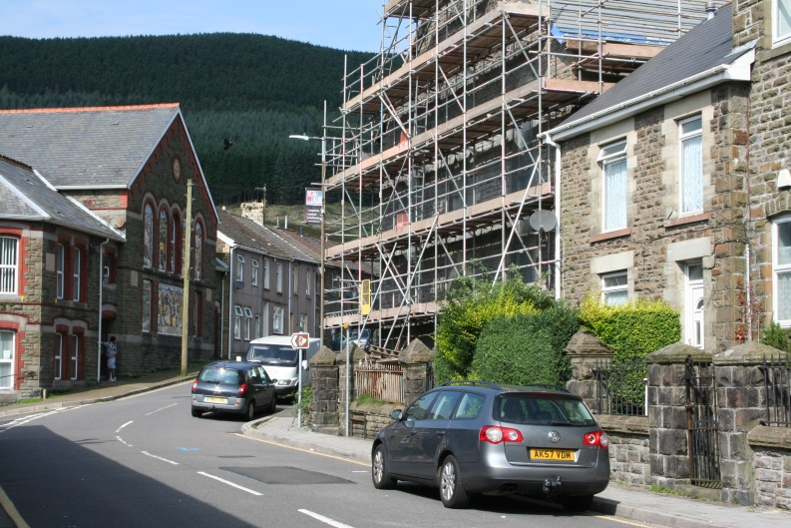
Microclimates – what questions can be asked?

Slide 13

Microclimates – what questions can be asked?
Are there microclimatic changes across a valley?
Does land use affect microclimate?
How does vegetation affect microclimate?
Is there a heat island in a village?
How do weather conditions affect microclimates?

Slide 14
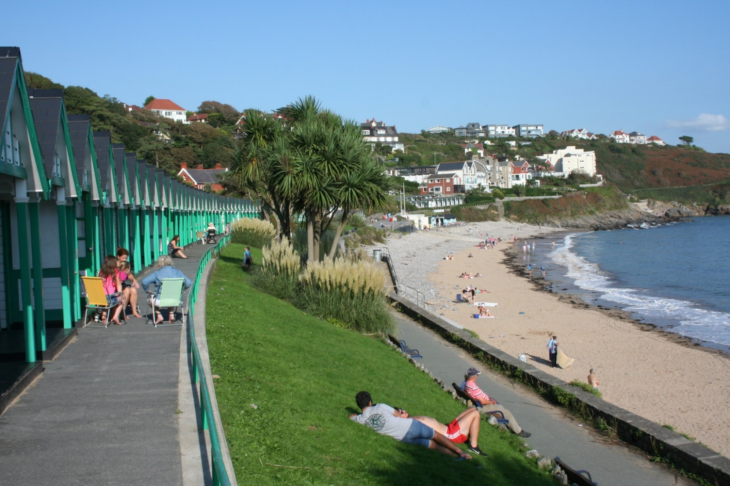
Tourism – what questions can be asked?

Slide 15

Tourism – what questions can be asked?
What are the environmental impacts of tourism?
Where do tourists come from?
Why are tourists attracted to the area?
What is the evidence that this is a honeypot site?

Slide 16
What factors make for a good investigation?
A It’s easy
C It is winter and it’s raining?
B It is based on sound geography theory
D The fieldwork location is accessible
E Data can be collected in a few hours
F There are shops nearby
G The river is in flood
H It can be conducted in a safe environment
I It’s a Bank Holiday
J It satisfies the nominated WJEC criteria

Slide 17
What makes a good investigation?
A It’s easy
C It is winter and it’s raining?
B It is based on sound geography theory
D The fieldwork location is accessible
E Data can be collected in a few hours
G The river is in flood
F There are shops nearby
H It can be conducted in a safe environment
I It’s a Bank Holiday
J It satisfies the nominated WJEC criteria
Under what conditions might some of the others be good?

Slide 18
Now convert your question to an investigation title
Keep the title short and focused
Use a question rather than an hypothesis
Make sure that the scale is appropriate – not too big or too small
Check the locations are accessible and safe
Make sure that you will be able to collect plenty of data

Slide 19
Nominated criteria
Table A: Methodologies
2018: Geographical flows
2019: Qualitative surveys
2020: Use of transects
Table B: Conceptual framework
2018: Cycles and flows
2019: Place
2020: Sphere of Influence

