Slide 1
Applied Fieldwork Enquiry
2. Data collection

Slide 2

The six stages of the enquiry process
Ask questions
Collect data
Process & present data
Draw conclusions
Evaluate the process
Analysis and application of wider understanding

Slide 3
How is evidence collected?
This involves using appropriate equipment to obtain accurate and reliable data from both primary and secondary sources
It includes:
Selecting appropriate locations for data collection
Justifying sampling size and type
Collecting data using quantitative and qualitative techniques

Slide 4
Sampling method
Random – every point (or line) stands an equal chance of being selected. You can use a random numbers table or phone app to select a two digit number that can be related to a map or tape measure
Systematic – data collected at regular intervals, which ensures that an even spread of data is collected, for example, along a beach transect
Stratified – sites are located deliberately introducing bias, such as access points along the course of a river
Explain why a particular sampling method has been used in your investigation

Slide 5
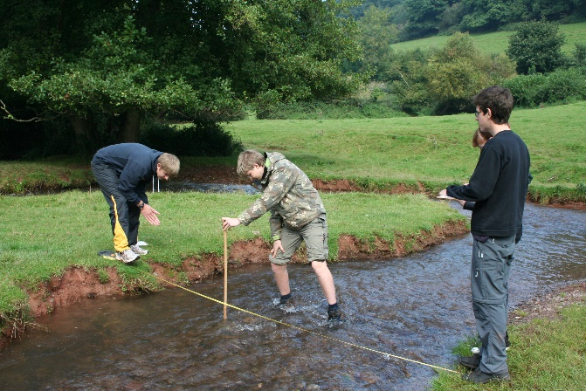
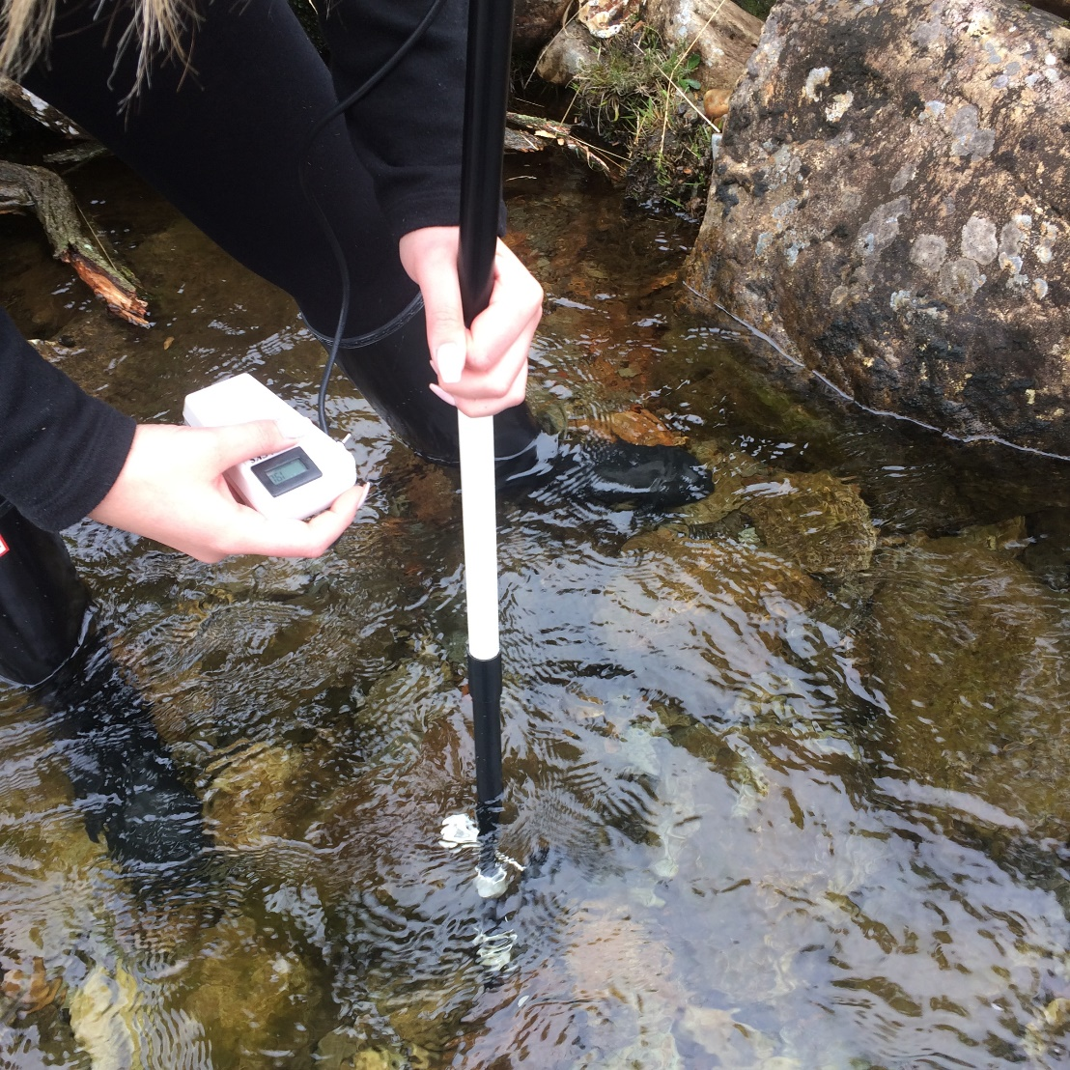
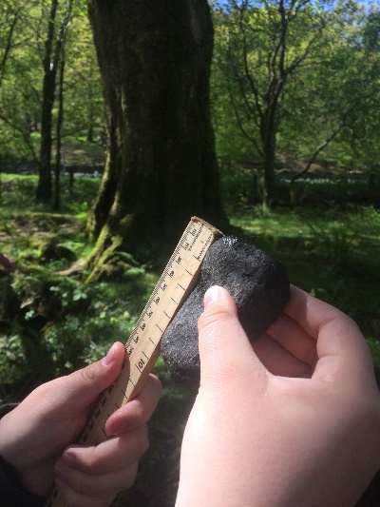
Discuss sampling strategies for these examples of data collection
Measuring width and depth
Measuring velocity
Measuring pebble size
© 2017 Snowdonia National Park Authority SNPA

Slide 6
Sample size
The aim of a sample is to collect enough data to be representative of the population as a whole ... Without having to measure every individual!
The larger the sample, the more reliable it is likely to be, for example:
  When studying pebbles, aim for a minimum of 30
  If you plan to draw a scatter graph, aim for about 10+ sets of data
  If you intend to draw an isoline map, make sure you have a good spread of points

Slide 7
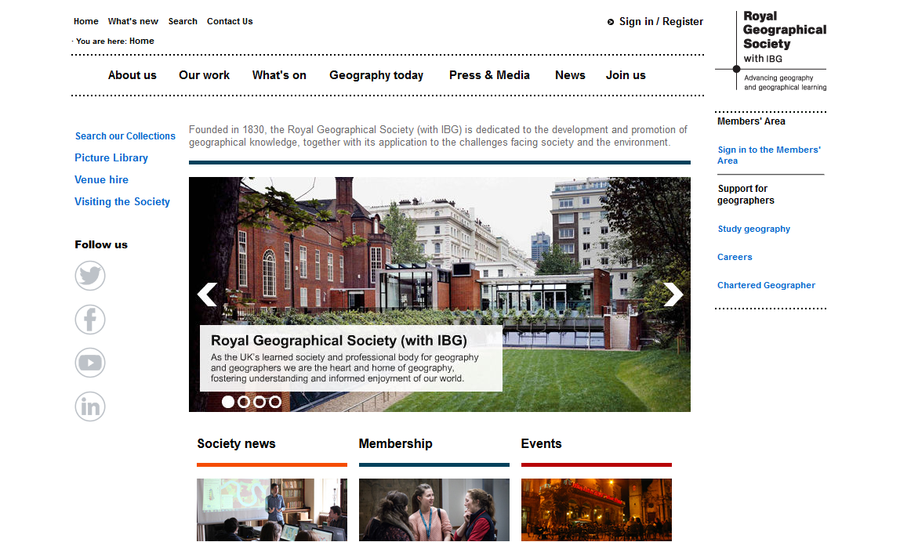
Fieldwork advice from the RGS
http://rgs.org

Slide 8
How to obtain accurate and reliable results
Geography fieldwork involves collecting accurate data to enable us to draw reliable conclusions:
practice using unfamiliar equipment
take time and care to make sure the data you collect is precise and accurate
double-check your measurements
record your results accurately

Slide 9
Quantitative techniques
Techniques should include those that measure:
flow (for example, discharge, infiltration, traffic)
scale (for example, river width, pebble size, gradient)
spatial pattern (for example, retail land use, sediment sorting)
temporal change (for example, temperature, rainfall, pressure)

Slide 10
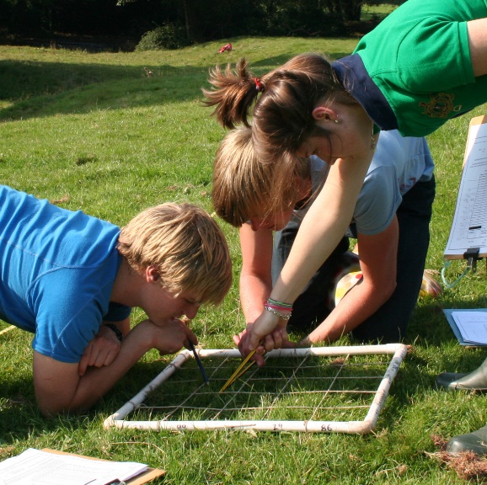


Quantitative techniques
© 2017 Snowdonia National Park Authority SNPA
What methods are being used? What is being measured?

Slide 11
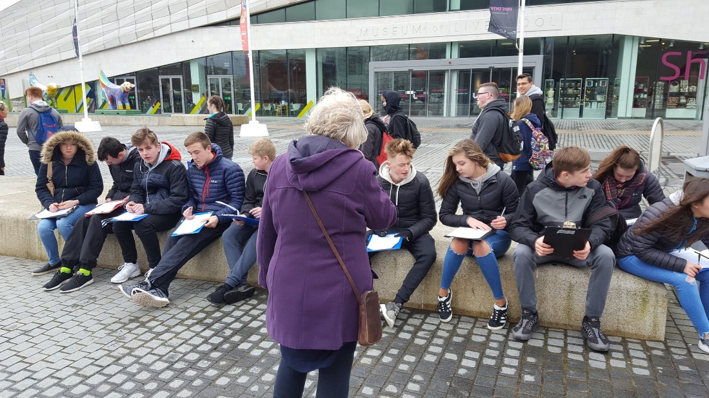
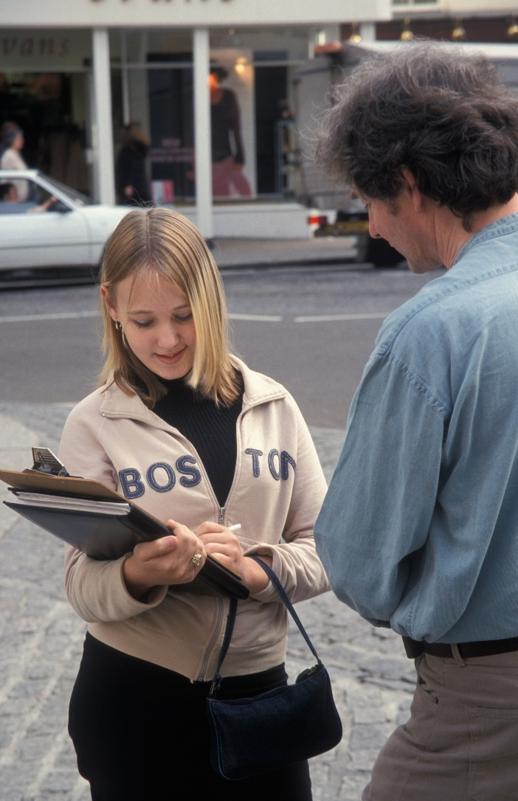
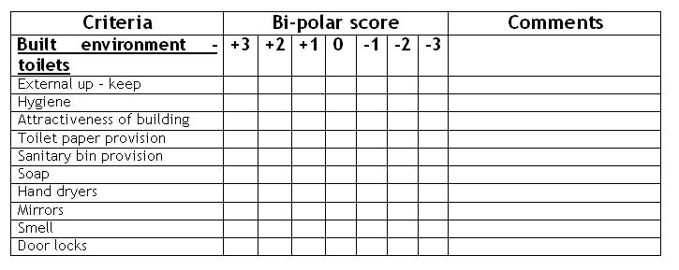
Qualitative techniques
What methods are being used? What is being measured?

Slide 12
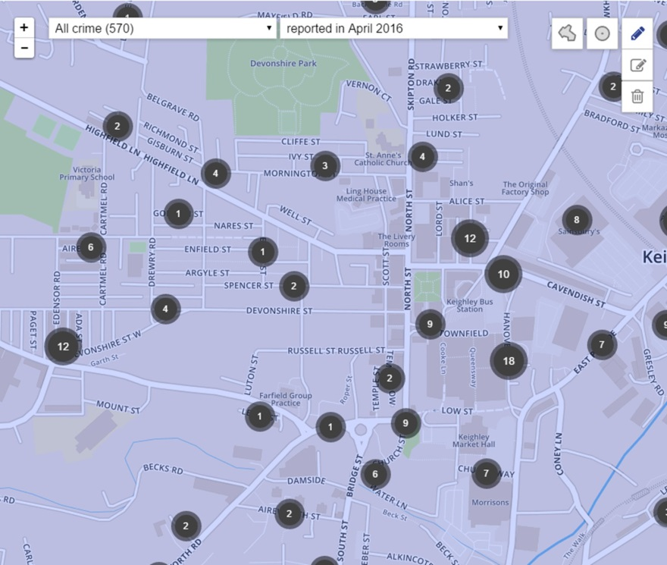
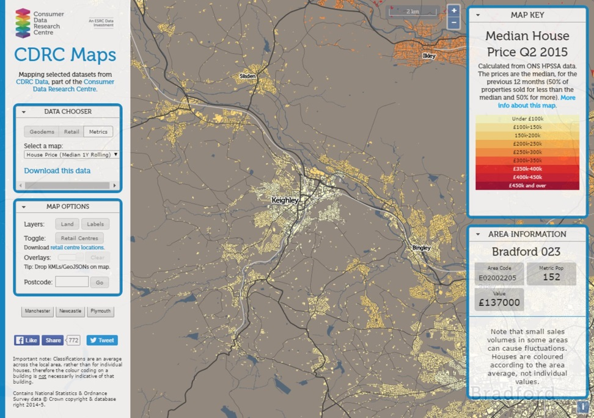
Secondary sources
Crime data
Consumer Data Research Centre
Crime data
Raw data from Police.uk website. Crime map for Keighley by Police.uk / Contains public sector information licensed under the Open Government Licence v3.0.
Median house price in Keighley, West Yorkshire by CDRC / Contains National Statistics & Ordnance Survey data © Crown copyright & database right 2014-5.

Slide 13
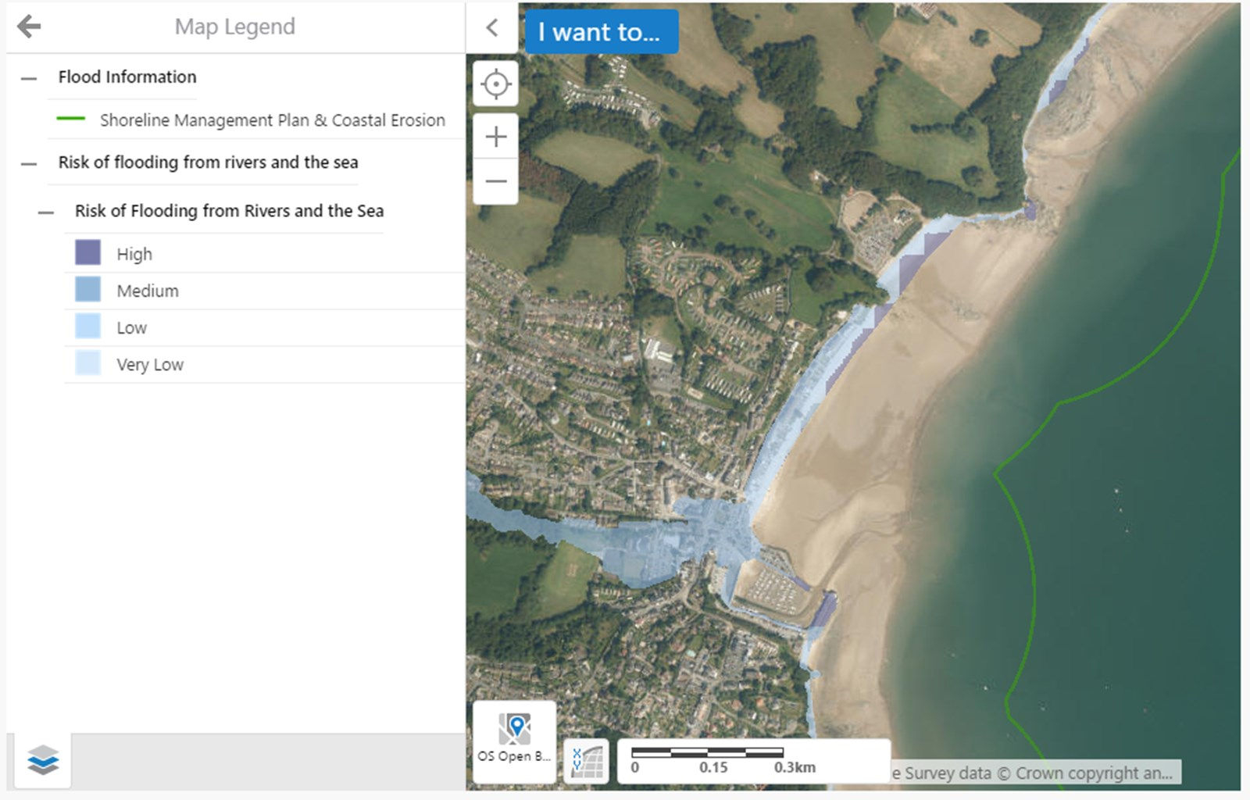
Secondary sources
Natural Resources Wales – satellite flood risk map

Slide 14
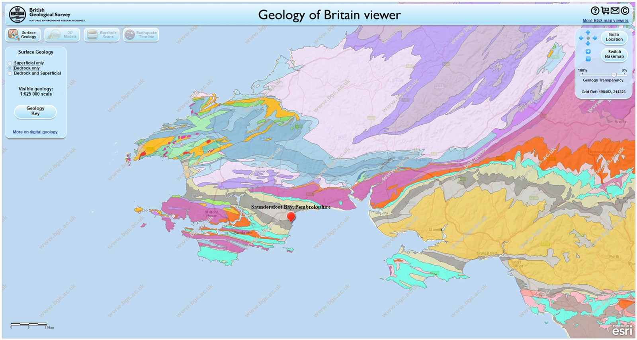
Secondary sources
British Geological Survey – Geology of Britain
https://www.geography-fieldwork.org/gcse/coasts/coastal-processes/secondary-data/

Slide 15
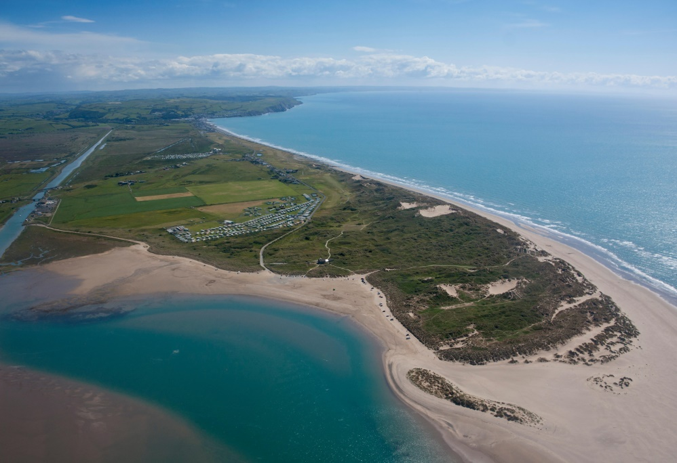
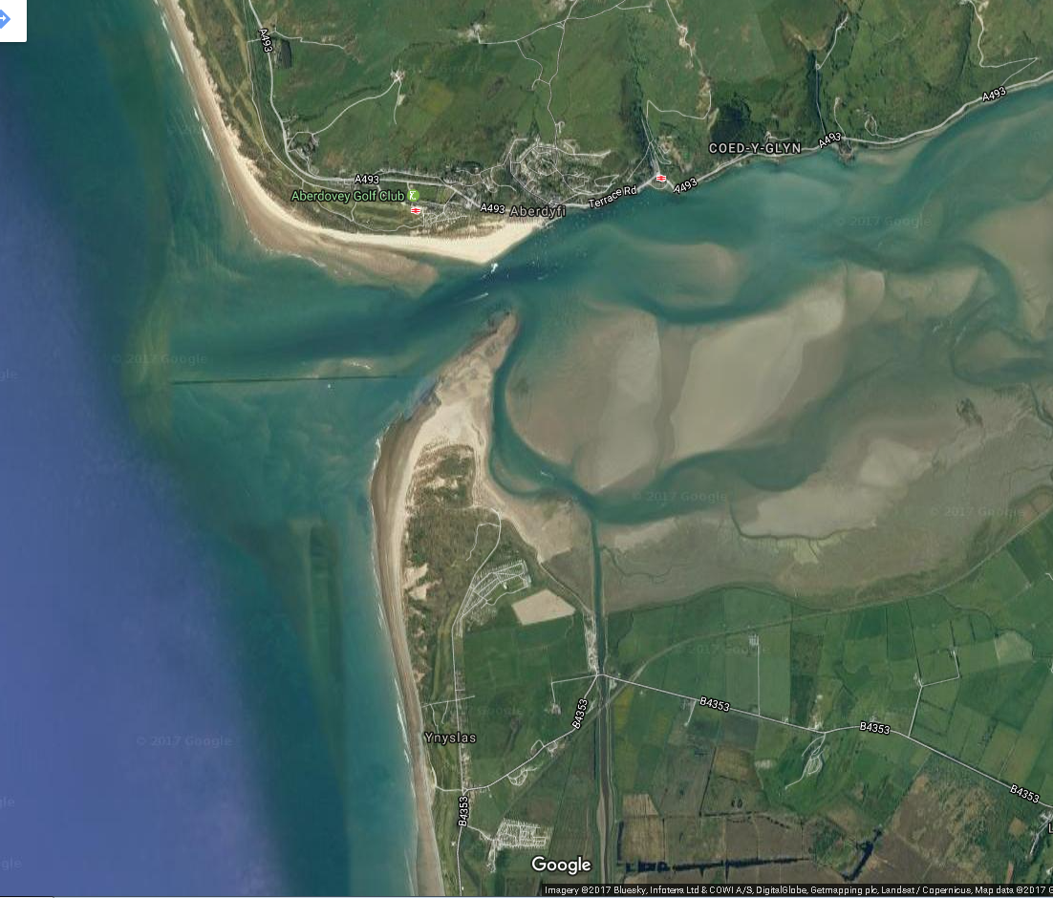
Secondary sources
Aerial and satellite photos – Ynyslas sand dunes

Slide 16
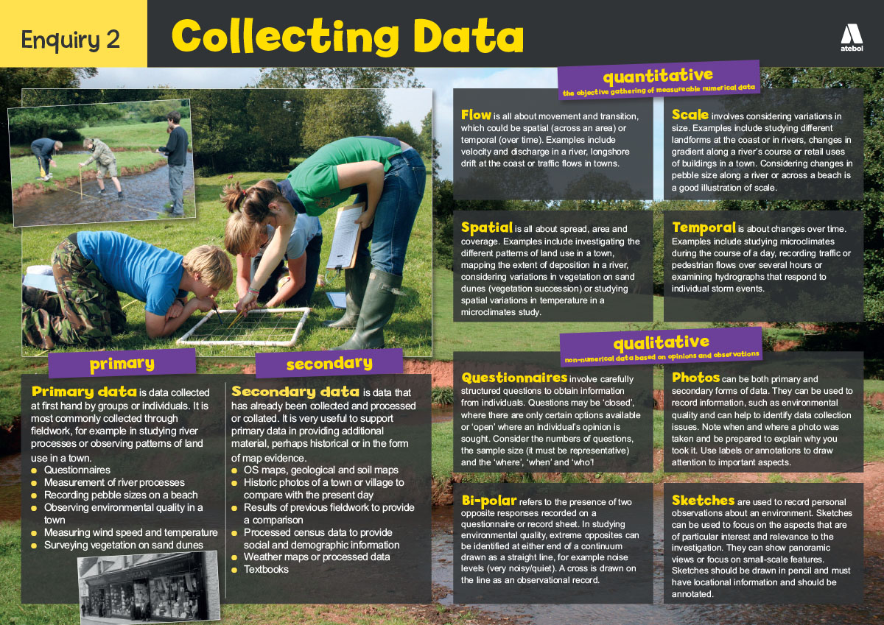
Take a look

Slide 17
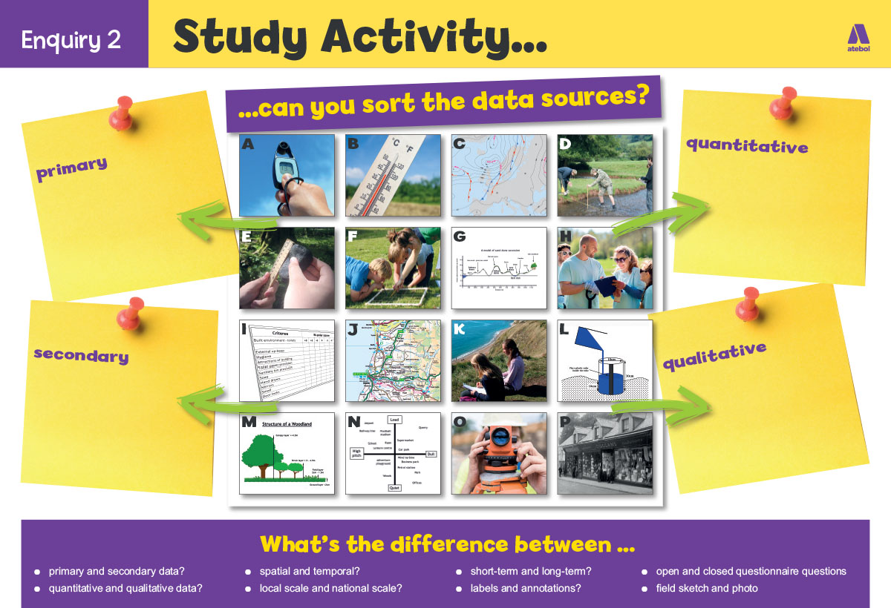
Can you sort the data sources?

Slide 18
Nominated criteria
Table A: Methodologies
2018: Geographical flows
2019: Qualitative surveys
2020: Use of transects
Table B: Conceptual framework
2018: Cycles and flows
2019: Place
2020: Sphere of Influence

