Slide 1
Applied Fieldwork Enquiry
3. Data processing and presentation

Slide 2

The six stages of the enquiry process
Ask questions
Collect data
Process & present data
Draw conclusions
Evaluate the process
Analysis and application of wider understanding

Slide 3
How can data be processed?
Raw data often needs to be processed to make it easier to see trends and patterns.
Mean – this is an average value for a data set and enables comparisons between data sets, e.g. average pebble size at different sites. Sum the values for a data set and divide by the number of values.
Percentage – this calculation expresses a value as a percentage, i.e. out of 100. If 15 out of 50 pebbles are very angular, this equates to 30%. This calculation also enables comparisons to be made between data sets.

Slide 4
How can data be presented?
Data can be presented in the form of maps, graphs and diagrams. The presentation of data helps to visualise and identify trends, patterns and relationships.
Maps – these can include sketch maps, geological maps, OS maps and GIS or satellite images. Maps can be annotated or used as base maps for located symbols (bars, circles, pies). Make sure you always include a scale and a north arrow.
Graphs – these can include line graphs, bar graphs, histograms, pie charts and scatter graphs. Make sure you always label the axes and use the same scale if drawing comparative graphs.
Diagrams – diagrams can be used to illustrate processes and landforms, systems and cycles, for example, how the process of longshore drift affects coastal landforms.

Slide 5
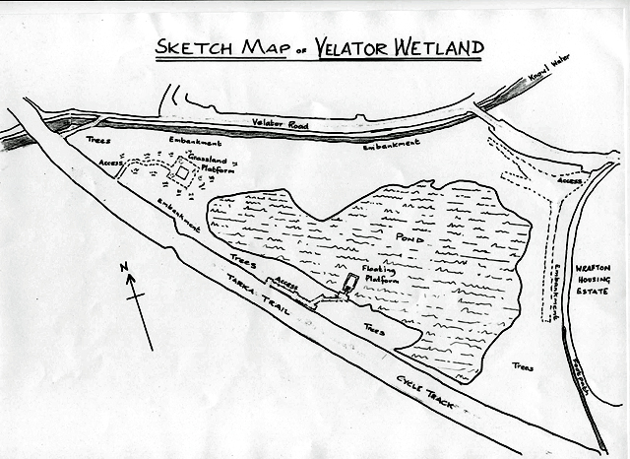
Sketch map
How could this sketch be used to present data? Could it be improved?

Slide 6
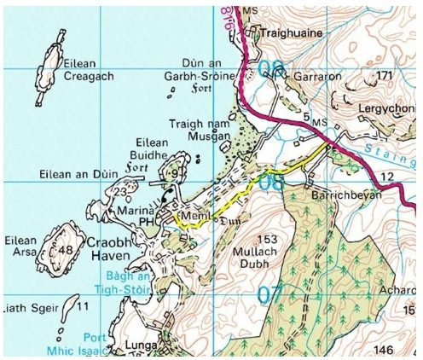
Ordnance Survey map (1:50,000)
How useful is this map scale for a geographical investigation?
What could be plotted on this map?

Slide 7
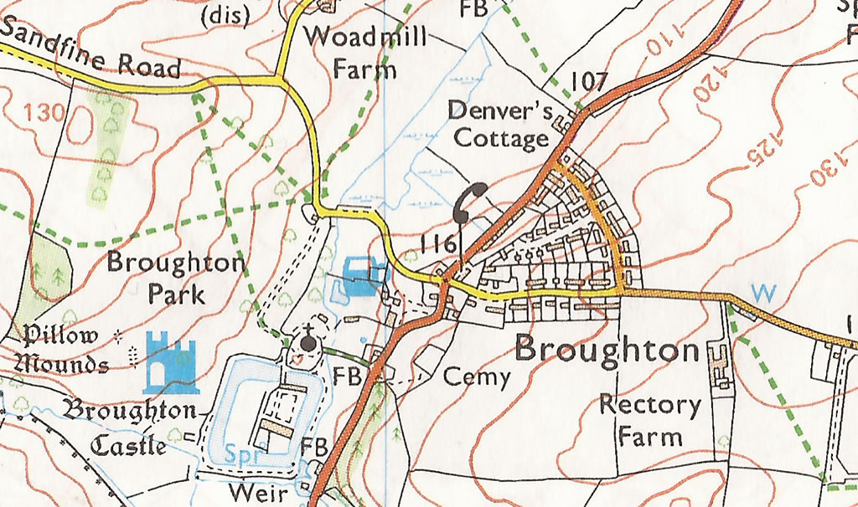
Ordnance Survey map (1:25,000)
How useful is this map scale for a geographical investigation?
What could be plotted on this map?

Slide 8
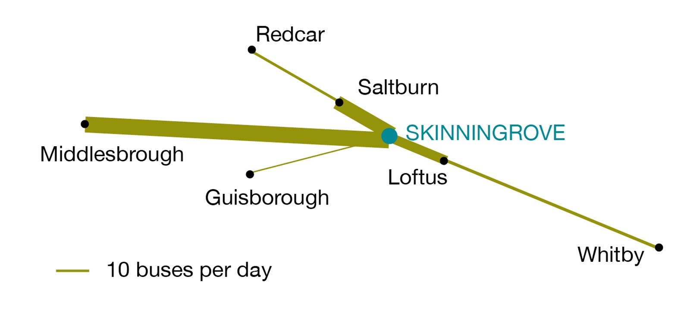
Flowline map showing number and direction of buses to the village of Skinningrove
Could this map be improved?

Slide 9
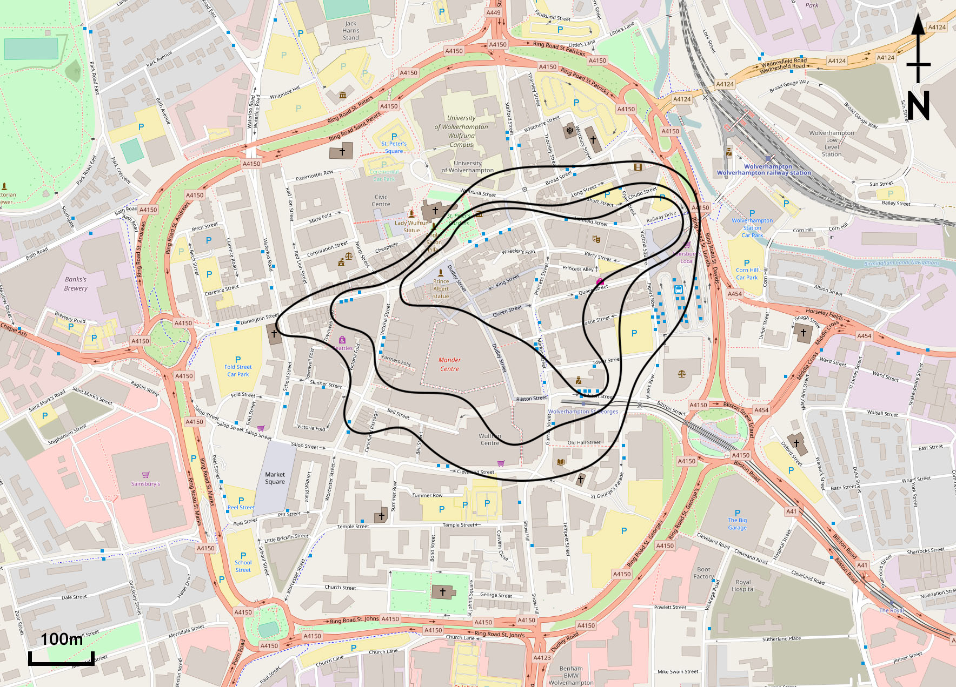
Isoline map showing pedestrians in Wolverhampton

Slide 10
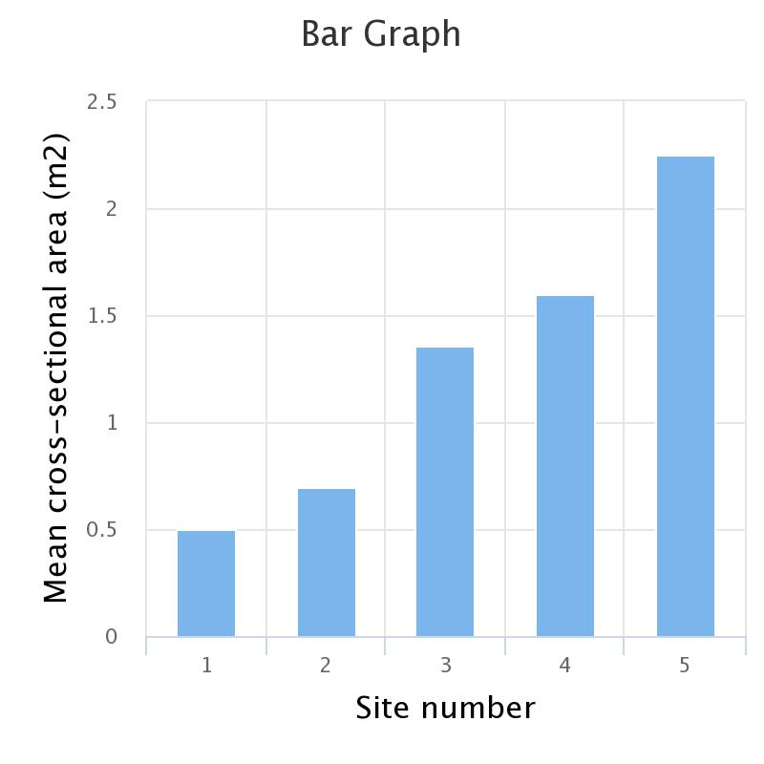
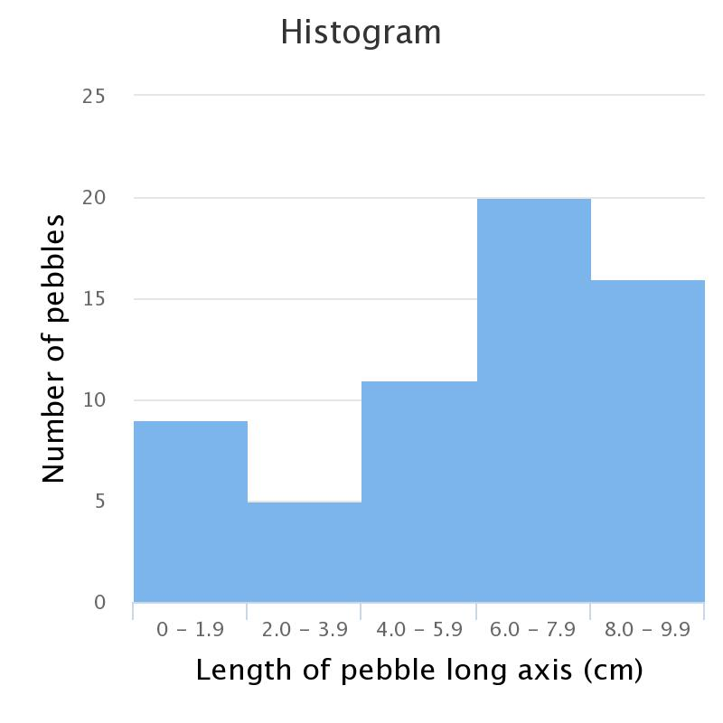
Bar graphs and histograms
Bar graphs show discontinuous data, e.g. for different sites
Histograms show continuous data, e.g. pebble size categories at a single site
Leave a gap
between the bars

Slide 11
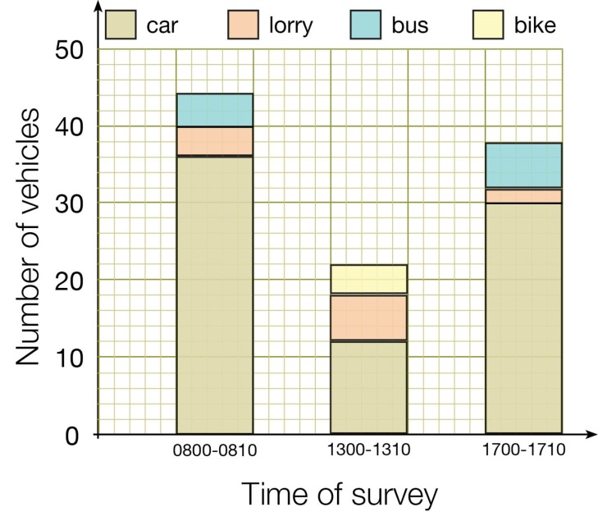
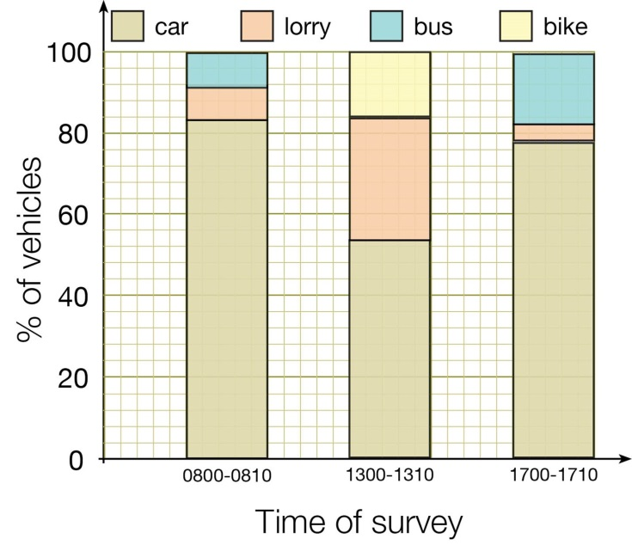
Divided bars and percentage bars
Divided bars are used to sub-divide separate categories
Percentage bars show the percentage of each sub-division

Slide 12
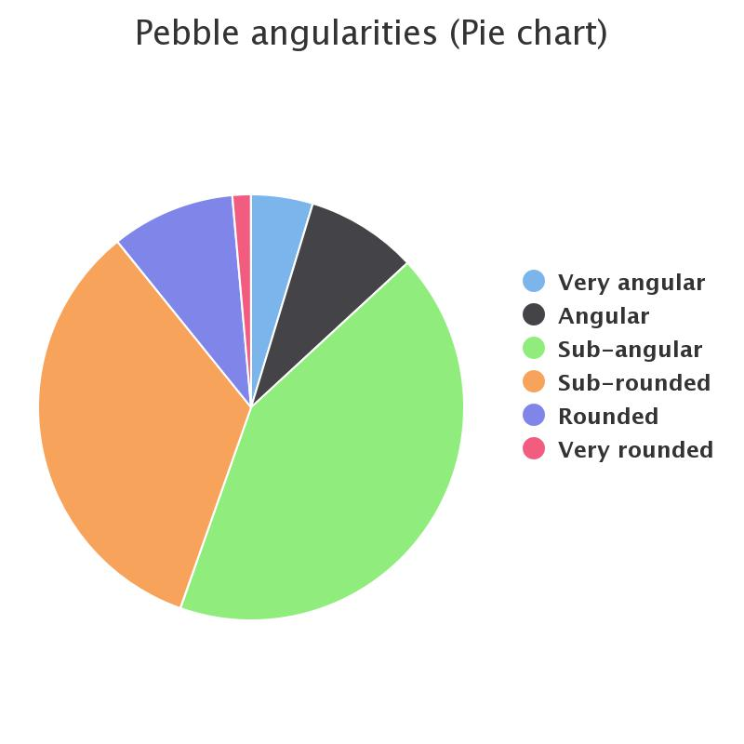
Pie chart
Pie charts are circles divided into sectors. Each sector represents a percentage.

Slide 13
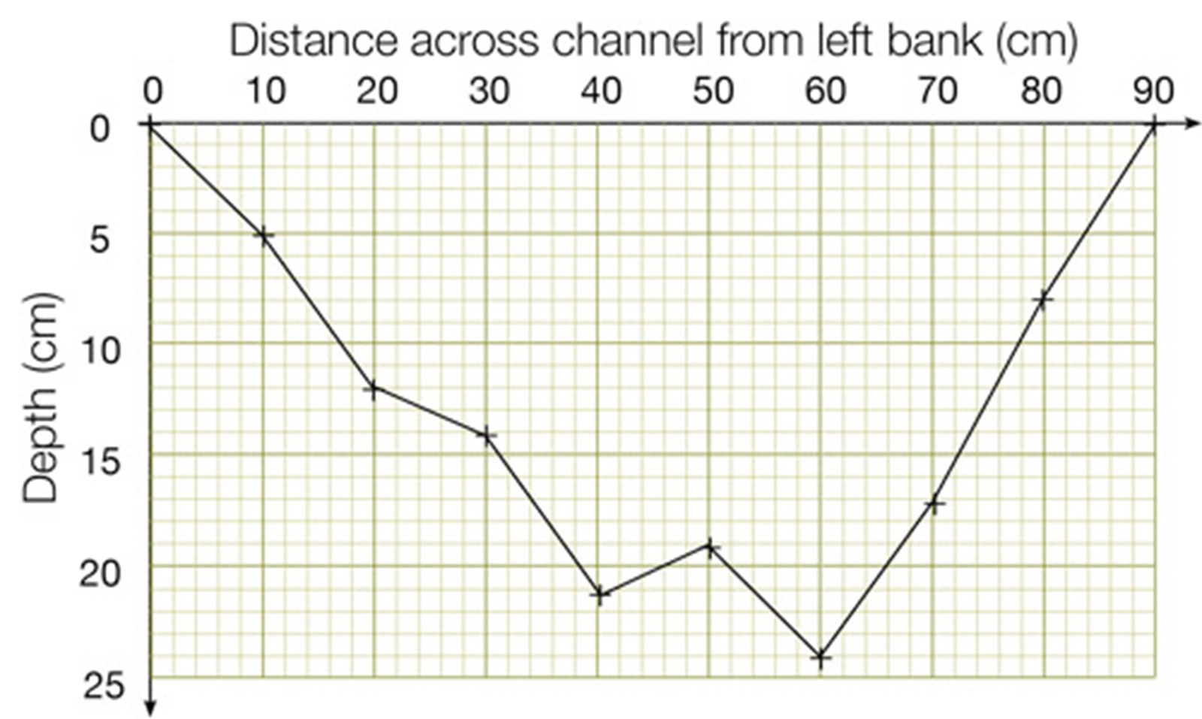
Line graph
Line graphs are used to show continuous data, usually over distance or time

Slide 14
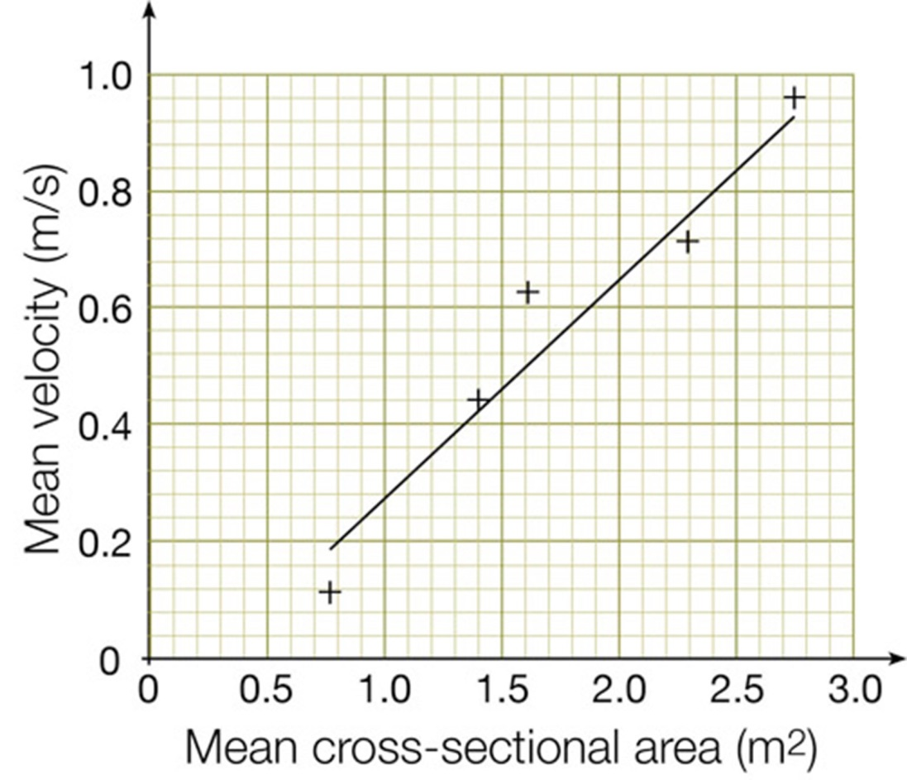
Scatter graph
Scatter graphs are drawn to show relationships between two sets of data.
The independent variable is plotted on the x-axis and the dependent variable
on the y-axis.
Best-fit line

Slide 15
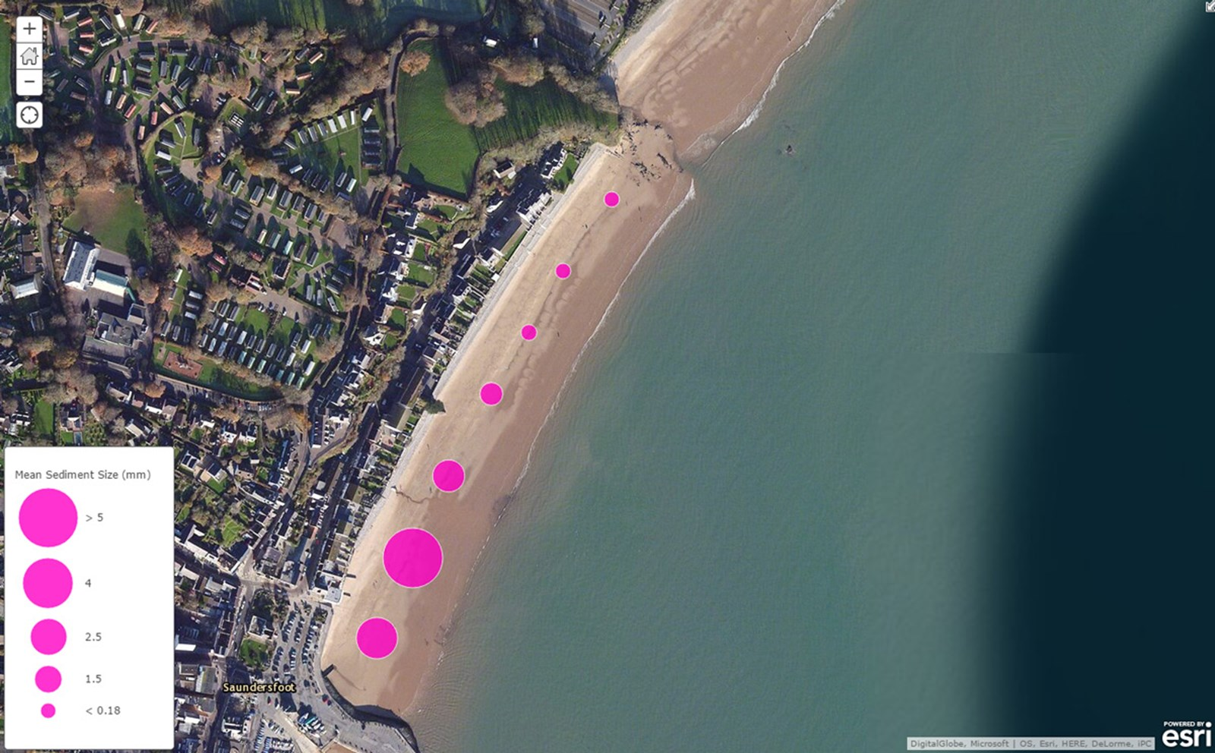
Using GIS to present data

Slide 16
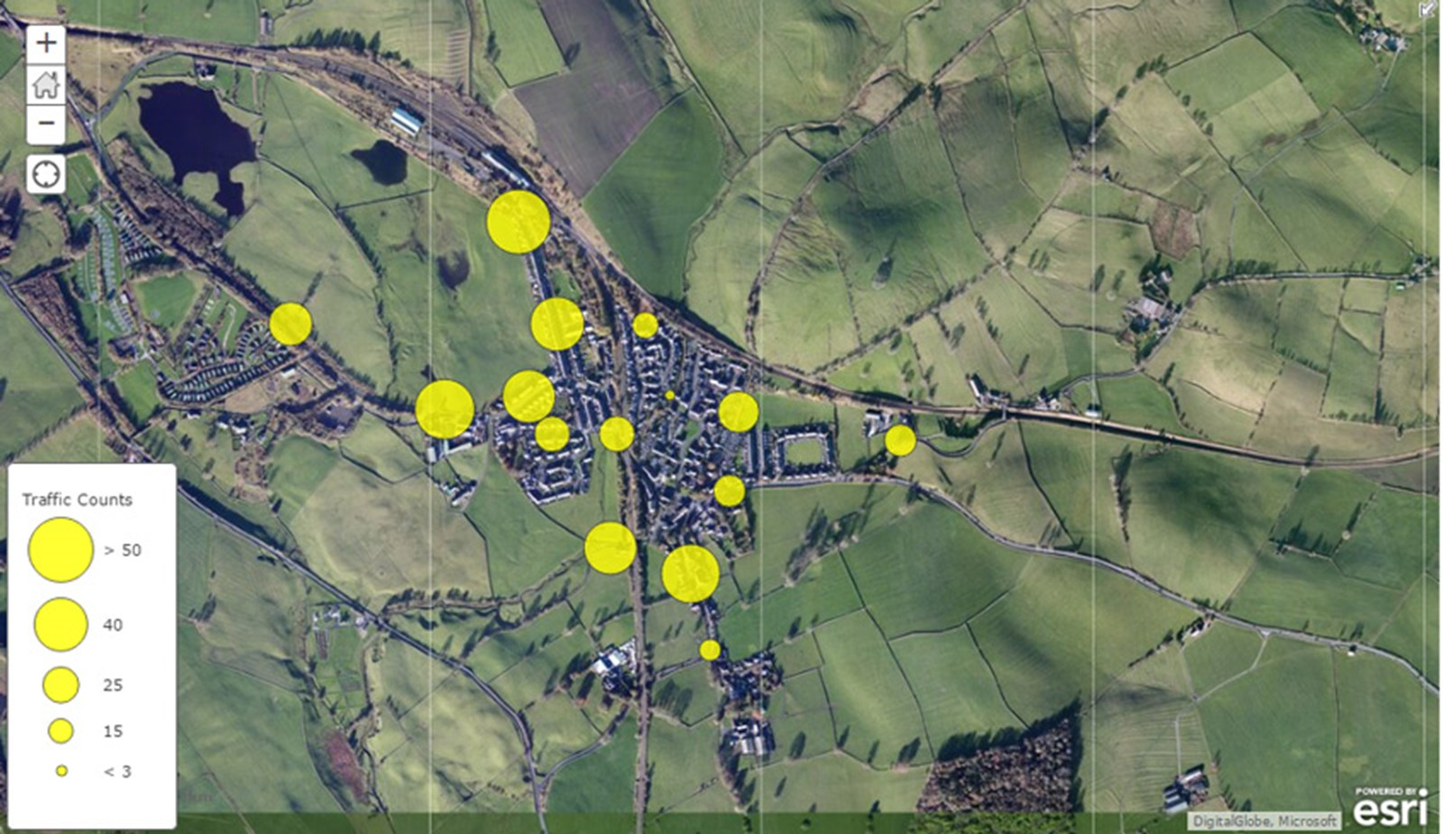
Using GIS to present data

Slide 17
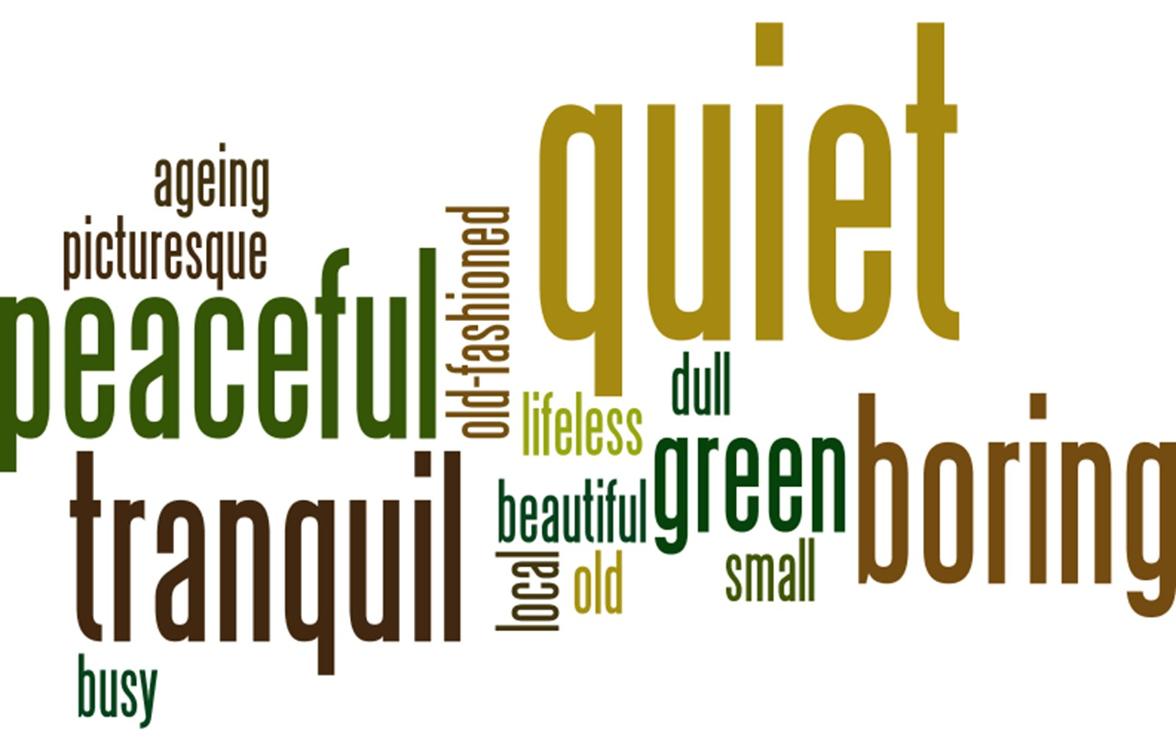
Using word clouds to present data

Slide 18
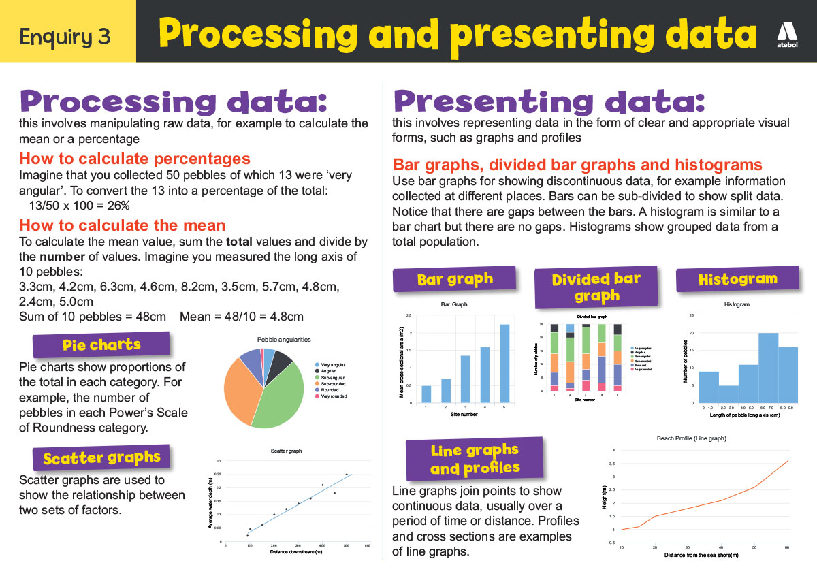
Now take a look!

Slide 19
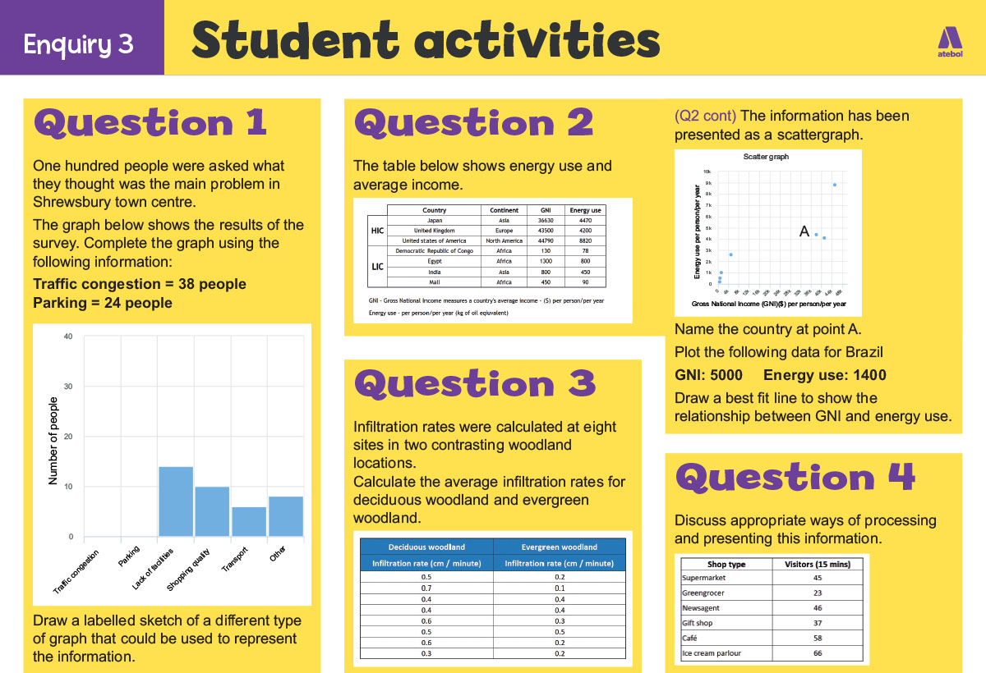
Now have a go!

Slide 20
Nominated criteria
Table A: Methodologies
2018: Geographical flows
2019: Qualitative surveys
2020: Use of transects
Table B: Conceptual framework
2018: Cycles and flows
2019: Place
2020: Sphere of Influence

