Slide 1
Applied Fieldwork Enquiry
5. Conclusions

Slide 2

The six stages of the enquiry process
Ask questions
Collect data
Process & present data
Draw conclusions
Evaluate the process
Analysis and application of wider understanding

Slide 3
How to draw conclusions?
When writing your conclusion you need to:
Synthesise your findings – this means pulling it all together by writing a broad overview of your results as a whole
Reach evidenced conclusions – back up your overall concluding (summary) statements with evidence
Appreciate that geography can be ‘messy’ – the real world is complex and you don’t always get what you expect! Be prepared to suggest possible reasons for unexpected results.

Slide 4
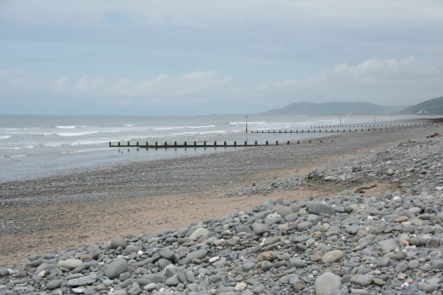
Drawing conclusions: coasts
Here’s an example:
‘In conclusion, my results clearly show that longshore drift is operating along the coast from south to north. This is supported by the increase in beach size (cross-sectional area) and the trapping of sediment on the southern side of wooden groynes (average 45cm fall on the northern side).
These results can be explained by longshore drift operating from south to north. There is also a decrease in pebble size (Site 1 average of 28cm; Site 6 average of 8cm) and angularity (Site 1 65% of pebbles were angular or very angular; Site 6 88% were either rounded or very rounded). As pebbles are transported by longshore drift, they are eroded by attrition and abrasion.’

Slide 5
Drawing conclusions: ‘messy’ coasts
Expected trends and models are not always reflected in the real world, for example:
Longshore drift does not always occur in the same direction along a beach due to changes in wind direction
Storms can significantly change beach landforms in a very short period of time
Human factors such as coastal management, beach profiling and offshore dredging can affect coastal processes and landforms
Sand dune systems can be affected by human activities such as tourism, water drainage and farming practises

Slide 6
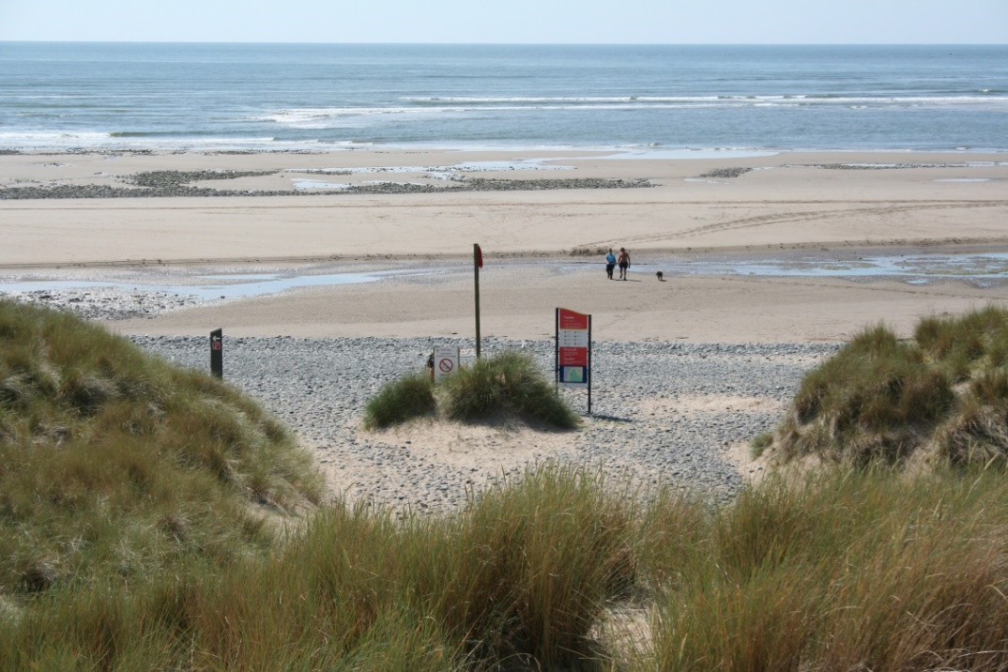
Enquiry 5: ‘Messy’ coasts
The position of the tide on the beach can affect data collection and could lead to unreliable
Access may be limited to parts of the beach or sand dunes
Weather conditions (e.g. stroms) can affect waves, coastal processes and coastal landforms
Human activity, such as management, tourism and coastal defences can affect coastal processes and landforms

Slide 7
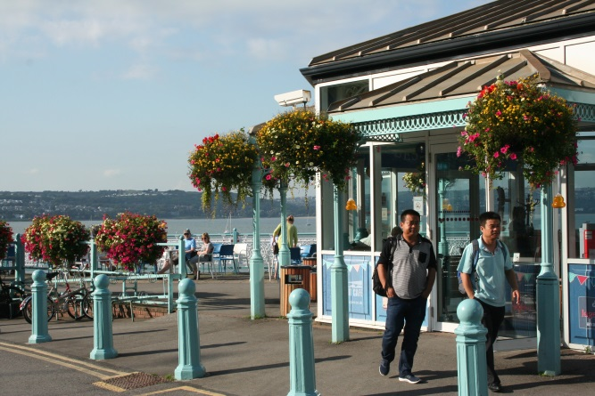
Drawing conclusions: tourism
Here’s an example:
‘In conclusion, my results show that tourism is being well managed at Mumbles. There is a wide promenade that is clearly marked to separate cyclists from pedestrians.
Cars are discouraged from parking on the road (double yellow lines, etc) and there are several car parks, all of which had plenty of spaces (over 15%). The area is well tended, with attractive flower borders and hanging baskets at the pier. My EIA results indicated a high environmental quality (over 90%), although there were a few pockets of litter accumulation and some dog poo!

Slide 8
Drawing conclusions: ‘messy’ tourism
Expected trends and models are not always reflected in the real world, for example:
The weather can have a huge impact on tourism – numbers of people and tourist responses to questionnaires
The time of day can affect results (coach parties, lunch time, etc)
The time of year can affect tourist numbers and types of tourist – most student fieldwork is done outside family holiday periods
It is not always possible to separate out tourists from local residents

Slide 9
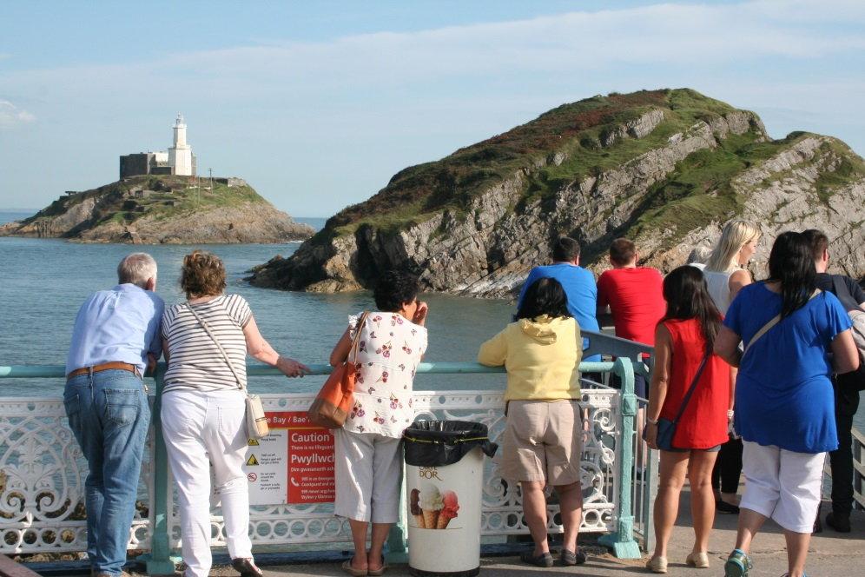
‘Messy’ tourism
Extreme weather conditions will affect people’s behaviour and may give unexpected or biased results
Access may be limited to some areas which will affect tourist patterns and numbers
Infrequent events, such as festivals or the arrival of a coach party may give unexpected and unrepresentative results
Time of day and time of year will have a huge effect on tourism and might introduce bias

Slide 10
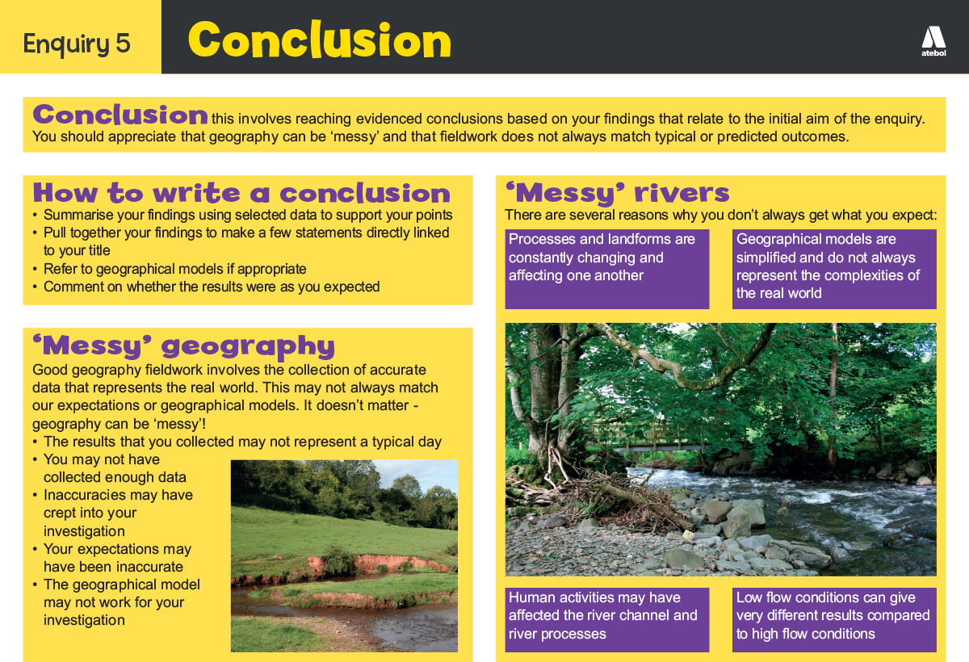
Now take a look!

Slide 11
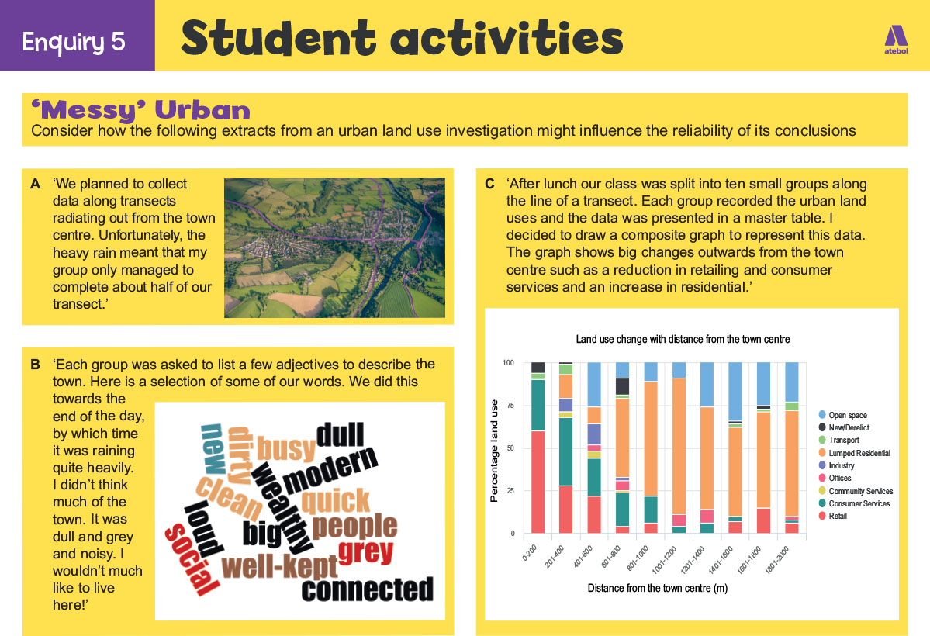
Now have a go!

Slide 12
Nominated criteria
Table A: Methodologies
2018: Geographical flows
2019: Qualitative surveys
2020: Use of transects
Table B: Conceptual framework
2018: Cycles and flows
2019: Place
2020: Sphere of Influence

