Slide 1
Applied Fieldwork Enquiry
6. Evaluation

Slide 2

The six stages of the enquiry process
Ask questions
Collect data
Process & present data
Draw conclusions
Evaluate the process
Analysis and application of wider understanding

Slide 3
How to evaluate the enquiry process?
Identify the limitations of geographical evidence - accuracy, reliability and bias
Reflect critically on the strengths and limitations of both primary and secondary data, methods used, conclusions drawn and knowledge gained
Appreciate that stakeholders may have vested interests introducing bias.

Slide 4
How to evaluate the enquiry process?
When evaluating the enquiry process you need to comment on:
Accuracy – how accurate were your measurements and other forms of data collection?
Reliability – how reliable were your results and subsequent conclusions?
Bias – to what extent were your results truly representative?

Slide 5
Evaluating data collection
Consider the strengths and limitations of your data collection:
Sampling technique – was it appropriate and did it generate representative data?
Sample size – did you collect enough data for it to represent the real world accurately?
Bias – was your data bias and potentially misleading in any way?

Slide 6
Evaluating primary data: coasts
Strengths
Limitations
Systematic sampling technique ensured pebbles were chosen across the whole beach
Measuring the long axis using callipers was straightforward and accurate
Measurements from the top of the groyne to the beach surface was accurate
The collection of 20 pebbles at each site may not be representative of the beach
Different people assessed pebble angularity – this lacks objectivity and introduces human error
Only 3 beach profiles may not represent the beach accurately.
Inaccurate use of technical equipment might have affected the results

Slide 7
Evaluating secondary data: coasts
Strengths
Limitations
Satellite map image helped to identify coastal management strategies that may have affected coastal processes
Satellite image shows variations in the extent of the beach
Historic map enabled changes in the beach to be identified
The satellite image was 15 years old so may not be a reliable reflection of the present day
Historic photos could not easily be pinpointed on the ground
1:50,000 map did not show variations in beach material and vegetation types

Slide 8
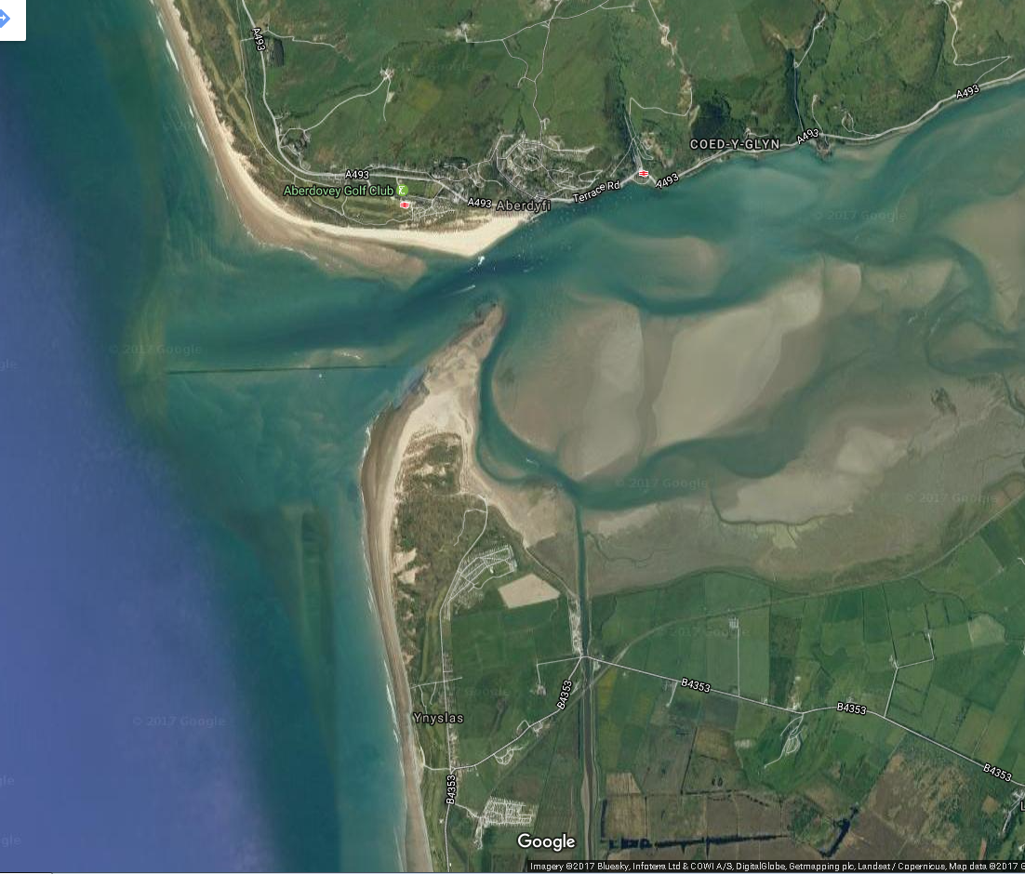
Coasts: what are the strengths and limitations of satellite photos?

Slide 9
Evaluating primary data: tourism
Strengths
Limitations
The questionnaire had an appropriate mix of open and closed questions
A large sample (100) of questionnaires were completed
Photos were taken throughout the day to indicate trends and patterns
Most people who answered the questionnaire were elderly - this did not reflect the tourists as a whole
A large number of respondents were part of a single coach party introducing bias
Data collection was focused in one area only

Slide 10
Evaluating secondary data: tourism
Strengths
Limitations
The historic maps show detailed changes in tourist attractions
The historic photos can easily be located and compared with present day views
Historic data comes from a reputable academic source so can be considered to be reliable
Photos were taken throughout the day to indicate trends and patterns
Local tourist board information might be slightly bias in promoting certain attractions of the area
Tourist data is annual so doesn’t show the trends and patterns throughout the year
People objecting to new tourist developments in the local newspaper may be stakeholders with vested interests

Slide 11
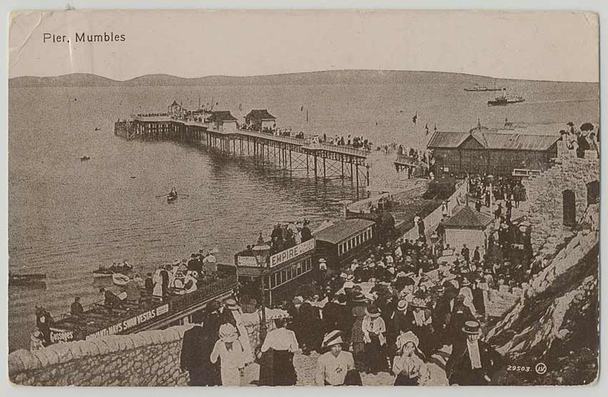
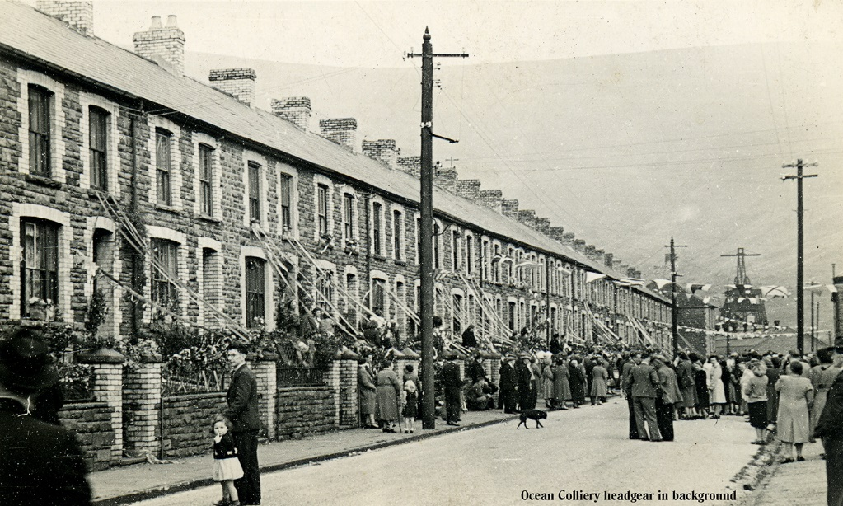
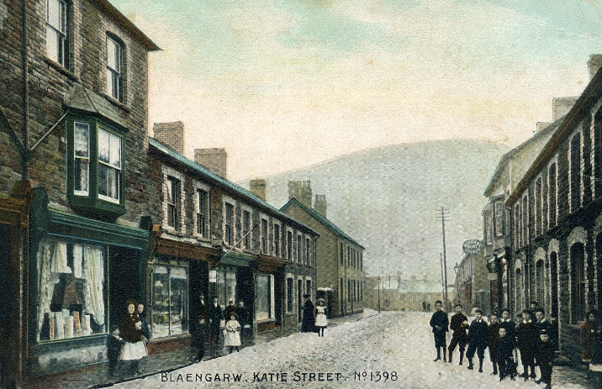
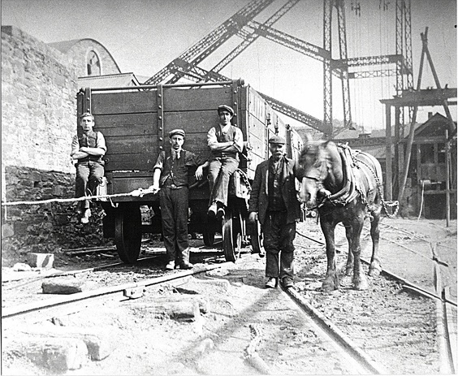
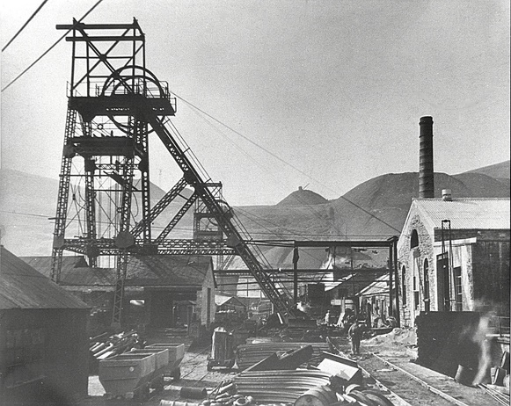
Tourism: what are the strengths and limitations of historic photos?

Slide 12
Evaluating your conclusion
How might your results be different on another day or at a different time of year?
To what extent did the weather affect the reliability your enquiry conclusions?
How might limitations and potential inaccuracies in your data collection have affected the reliability of your conclusions?
Could inaccurate or inappropriate diagram construction have affected your conclusions?

Slide 13
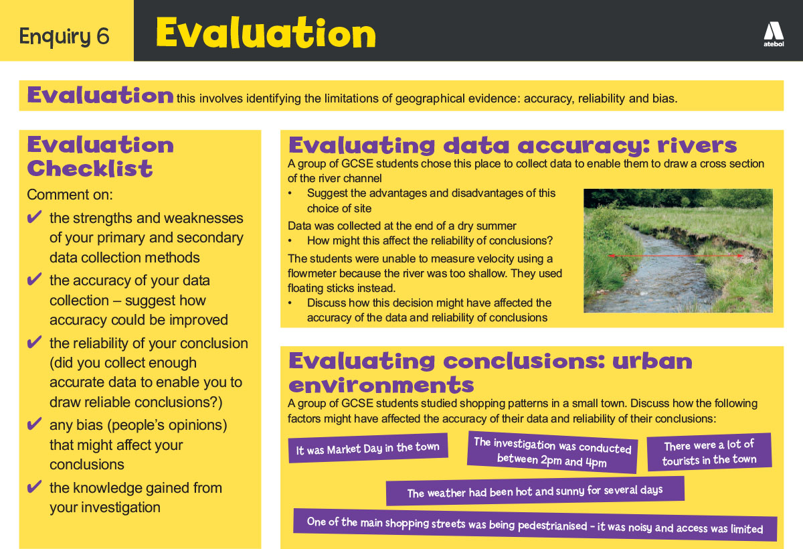
Now take a look!

Slide 14
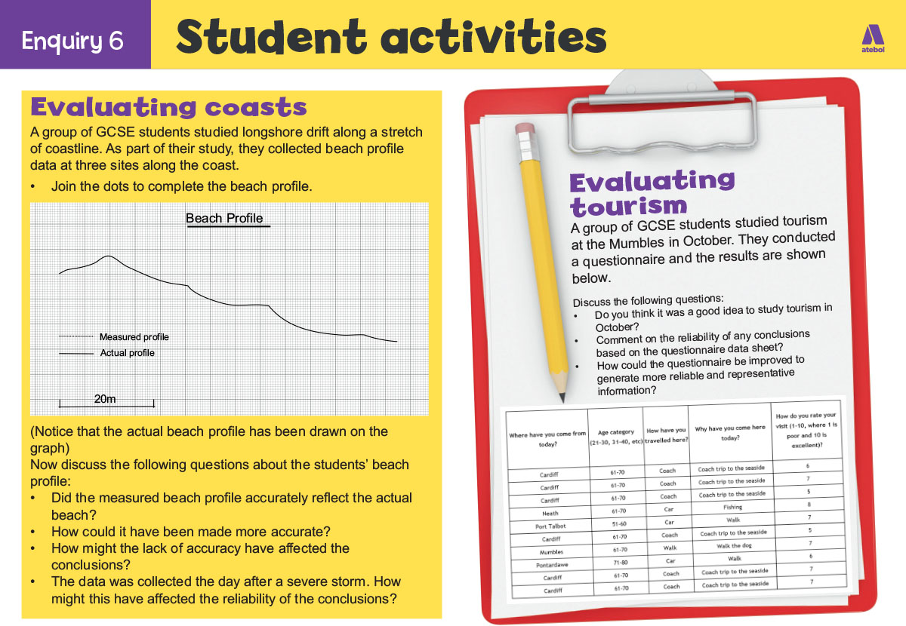
Now have a go!

Slide 15
Nominated criteria
Table A: Methodologies
2018: Geographical flows
2019: Qualitative surveys
2020: Use of transects
Table B: Conceptual framework
2018: Cycles and flows
2019: Place
2020: Sphere of Influence

