Slide 1
Applied Fieldwork Enquiry
Microclimate
Notes:
Microclimate – larger point size

Slide 2
Table A: fieldwork methodologies
Fieldwork locality | Use of transects (across a feature) | Change over time (comparing primary data with secondary sources) | Qualitative surveys (analysing perception) | Geographical flows (analysing flows and patterns of movement)
Weather/microclimate | Analyse micro-climate up a slope, through an area of woodland, open land, across an urban area or across a valley | Consider changing weather - compare data collected over several days with data collected for the same period in a previous year Investigate weather changes with a passing depression (using synoptic charts) | Investigate local people’s perception of climate change or an extreme weather event (e.g. flood, heatwave, heavy snowfall) | Investigate winds in a valley or within an urban area (which may be a result of temperature differences) Investigate weather changes with a passing depression (using synoptic charts)

Slide 3
Table B: conceptual frameworks
Geographical theme | Place Applying understanding of uniqueness / identity | Sphere of influence Applying understanding of sphere of influence / catchment and how it impacts on places | Cycles and flows Applying understanding of change and movement in relation to place | Mitigating risk Applying understanding of hazard perception / risk and analysing management strategies / future actions | Sustainability Applying understanding of sustainable communities | Inequality Applying understanding of inequality and associated concepts such as deprivation or equality of access to services
Weather/microclimate | Comparing microclimatic conditions between two places (e.g. woodland and open area, village centre and open fields) | Consider the sphere of influence of a heat island | Investigating local winds (katabatic/anabatic) in a valley and assessing the impacts on people and human activities Investigating weather associated with a passing depression | Consider perceptions of climate change and possible local responses Consider hazards associated with microclimates (e.g. frost hollows) and possible local responses | Assessing sustainable options to reduce the heat island effect caused by anthropogenic heat sources | Consider microclimatic inequalities in different parts of a settlement or across a physical feature (e.g. valley, ridge)

Slide 4
WJEC nominated criteria
Table A: Methodologies
2018: Geographical flows
2019: Qualitative surveys
2020: Use of transects
Table B: Conceptual framework
2018: Cycles and flows
2019: Place
2020: Sphere of Influence

Slide 5

The six stages of the enquiry process
Ask questions
Collect data
Process & present data
Draw conclusions
Evaluate the process
Analysis and application of wider understanding

Slide 6
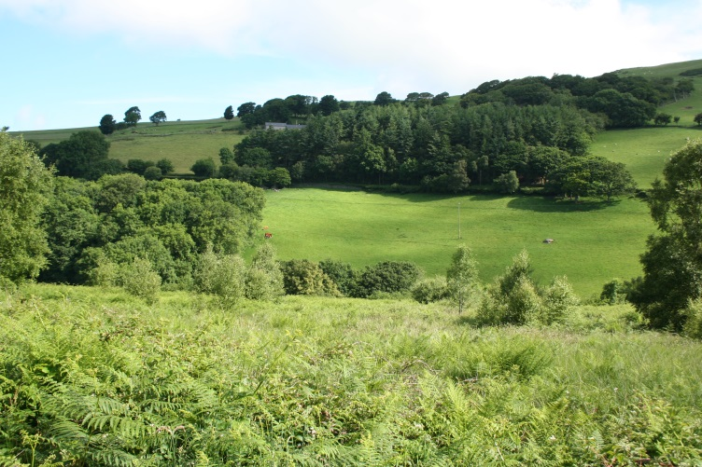
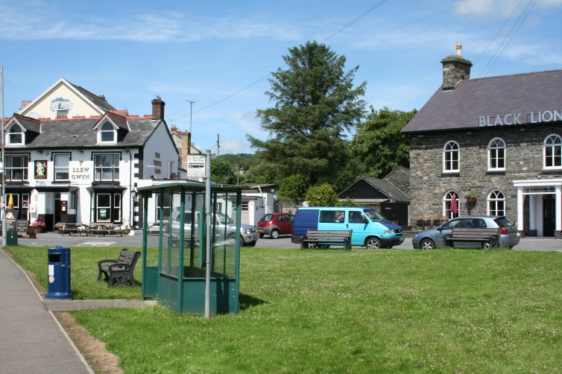
Enquiry 1: Ask questions
Does a valley have its own microclimate?
How does vegetation type affect microclimate?
Does microclimate vary with different types of weather?
Does a village have its own microclimate?
Does a town have an urban heat island?

Slide 7
Enquiry 2: Collecting data
Remember that for one of your two investigations, one of your data collection methods must be that nominated by WJEC from Table A
The second investigation must be underpinned by the nominated conceptual framework (Table B)
You can use additional methods of data collection as you wish
Remember that fieldwork is an excellent way to practice geographical skills

Slide 8
Enquiry 2: Microclimate methodologies
Fieldwork locality | Use of transects (across a feature) (2020 exam) | Change over time (comparing primary data with secondary sources) | Qualitative surveys (analysing perception) (2019 exam) | Geographical flows (analysing flows and patterns of movement) (2018 exam)
Weather/microclimate | Analyse micro-climate up a slope, through an area of woodland, open land, across an urban area or across a valley (measure temperature, light, wind speed and wind direction at points along a transect) | Consider changing weather - comparing data collected over several days with data collected for the same period in a previous year (measure microclimate aspects over a period of time) Investigate weather changes with a passing depression (using synoptic charts) (measure microclimate aspects at stages of a passing depression) | Investigate local people’s perception of climate change or an extreme weather event (e.g. flood, heatwave, heavy snowfall) (use questionnaires and photos) | Investigate winds in a valley or within an urban area (which may result from temperature differences) (measure wind direction and wind speed) Investigate weather changes with a passing depression (using synoptic charts) (measure microclimate aspects at stages of a passing depression)

Slide 9
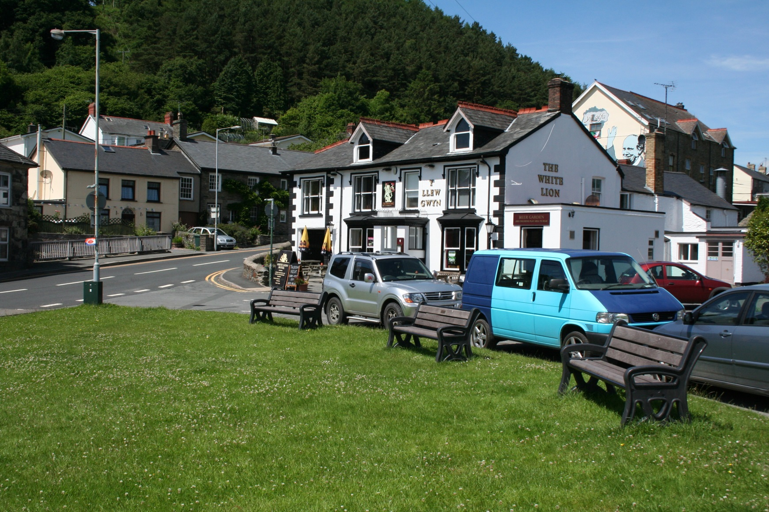
Enquiry 2: Tal-y-Bont
Consider what methodologies could be used here to collect data

Slide 10
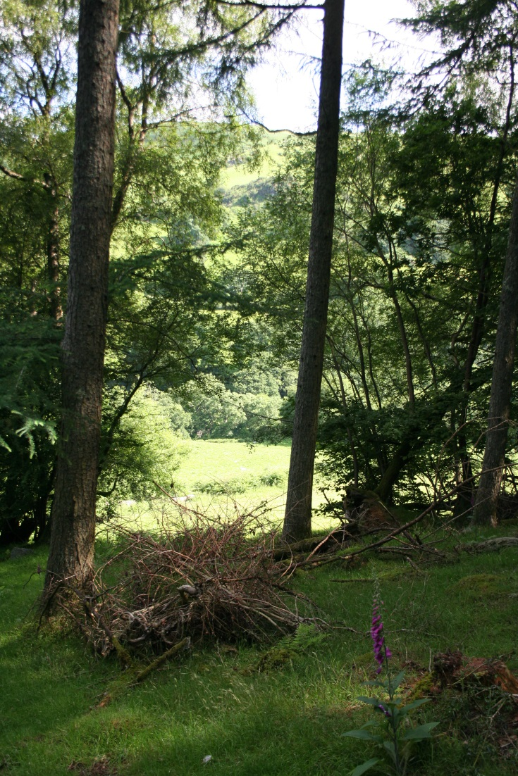
Enquiry 2: Woods near Tal-y-Bont
Consider what methodologies could be used here to collect data

Slide 11
Enquiry 2: Collecting data
Design appropriate fieldwork data collecting sheets
Select appropriate locations (safety – risk assessment - ease of access, geographically sound)
Select appropriate sampling techniques (random, systematic, stratified)
Ensure accuracy and reliability
Remember that students will need to justify methodologies

Slide 12
Enquiry 3: Processing and presenting
Processing data
This involves making calculations from the data sheet and could involve:
Calculating averages (e.g. temperature)
Converting data into percentages or degrees for the drawing of pie charts
Comparative statistical measures (e.g. percentage change or difference between places)

Slide 13
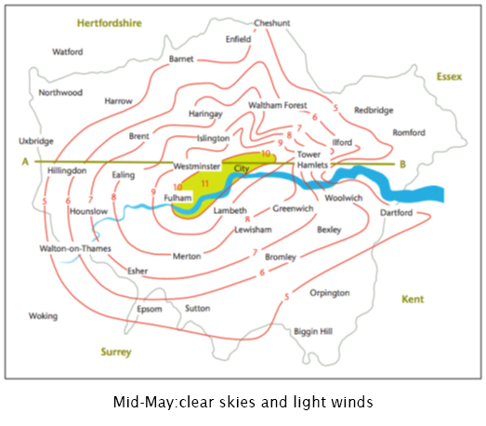
Enquiry 3: Processing and presenting
Presenting data
This involves selecting appropriate methods to present data and could include:
Isolines can be drawn to identify a heat island, such as this one in London.
Alternatively, located bars could be drawn onto a base map or by using GIS.
Notes:
Suggest in title of diagram that the second brackets are removed so that it reads:
Mid-May: clear skies and light winds

Slide 14
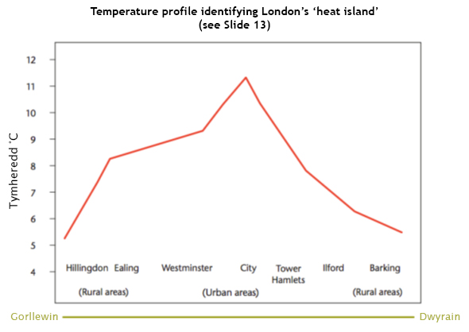
Enquiry 3: Processing and presenting
Presenting data
This involves selecting appropriate methods to present data and could include:
Line graphs can represent changes over an area, such as a town
Notes:
Title to diagram: Temperature profile identifying London’s ‘heat island’ (see Slide 13)

Slide 15

Annotated photo showing aspects of microclimate at Tal-y-Bont
Main road has higher temperatures due to dark tarmac absorbing heat from the sun plus vehicles emitting heat
Buildings on either side of the road funnels the wind
Heat loss from buildings from heating/cooking increases the temperature nearby
Vehicles produce heat causing slightly higher temperatures
Grassy area experiences higher humidity due to transpiration

Slide 16
Enquiry 4: Analysing and wider understanding
Identify, analyse and interpret trends and patterns
Apply knowledge and understanding of geographical concepts and processes to specific evidence collected
Trends – changes over time, distance, etc
Patterns – regular repeating distributions, e.g. linear, radial, circular

Slide 17
Enquiry 4: Describing data
When describing trends and patterns consider using the acronym ‘GCSE’:
GC – general comment, describing the ‘big picture’, the overall trends and patterns
S – refer to specific information/data on the graphs, maps and diagrams to support your comments
E – identify and comment on any exceptions (anomalies) to the overall trend/pattern

Slide 18
Enquiry 4: Analysing data
The line graph shows marked variations in temperature across the city.
On the outskirts of the city temperatures were between 5-6 degrees ˚C at Hillingdon and Barking. Temperatures increased towards the centre reaching about 11 degrees ˚C in the City.
Temperatures rose gradually in the east but as a series of ‘steps’ in the west, probably reflecting variations in surface land use. Temperatures rose significantly (by nearly 3 degrees ˚C) between Hillingdon and Ealing probably due to a sudden change from rural to urban land use.
The graph clearly shows the presence of an urban heat island caused by the emissions of heat (vehicles/buildings) and dark surfaces (tarmac) absorbing heat in contrast to the vegetated rural areas on the outskirts.
Notes:
Add title as Slide 14
Can the point size be increased so that the space is used more economically? Lots of white space on the left.

Slide 19

Enquiry 5: Drawing conclusions
This involves synthesising (pulling together) findings to reach evidenced conclusions that relate to the initial aim of the enquiry. Here’s an example:
‘In conclusion, my results showed clear differences in microclimate across the valley. There was a gradual decrease in temperature with the coldest conditions in the valley bottom. This was due to the cold (dense) air sinking to the lowest part of the landscape. This also explains why the winds tended to flow down the valley sides at the beginning of the day. There were some anomalies in temperature and wind direction, probably caused by trees and buildings interrupting airflow.’

Slide 20
Enquiry 5: Drawing conclusions
Expected trends and models are not always reflected in the real world, for example:
The weather can have a huge impact on microclimates – e.g. winds can mix up the air erasing subtle variations in temperature
The time of day can affect results - e.g. cold air may sink to the valley bottom in the early morning but start to rise as the ground heats up during the day
Instrument/human error can be significant given the subtle variations in the data gathered

Slide 21
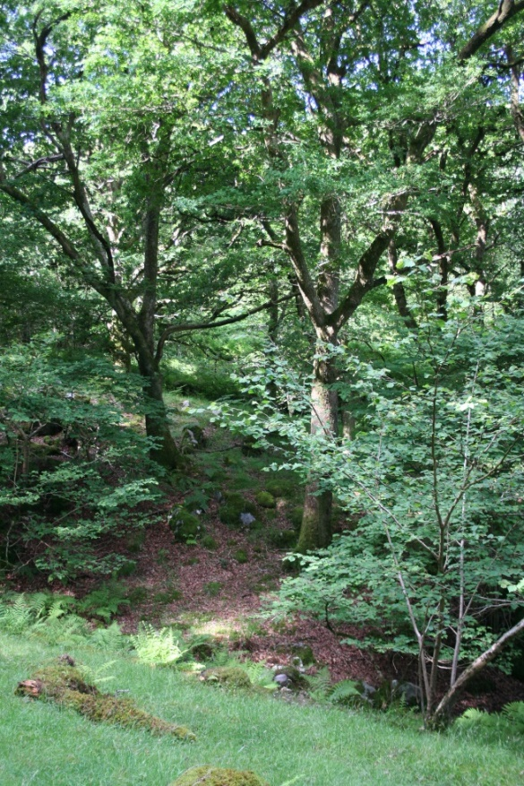
Enquiry 5: Drawing conclusions
Variations in tree types in a woodland will affect results
Weather conditions (such as cloud cover and strong winds) will affect measurements and could give unexpected results
Human factors such as woodland clearance could affect the results due to the localised increased exposure to sunlight
Time of year will affect canopy growth and the effect of shading – this may give unexpected results
Notes:
All arrows need to touch the box please

Slide 22
Enquiry 6: Evaluating the process
Identify the limitations of geographical evidence - accuracy, reliability and bias
Reflect critically on the strengths and limitations of both primary and secondary data, methods used, conclusions drawn and knowledge gained
Appreciate that stakeholders may have vested interests, introducing bias.

Slide 23
Enquiry 6: Evaluating the process
How might your results be different on another day or at a different time of year?
How might an increase in the sample size or the number of sites have improved reliability?
With practice, might data collection techniques have been more accurate?
Was the sampling strategy appropriate?
Could inaccurate diagram construction have affected your conclusions?

