Slide 1
Applied Fieldwork Enquiry
Rivers
Notes:
Rivers larger point size please

Slide 2
Table A: fieldwork methodologies
Fieldwork locality | Use of transects (across a feature) | Change over time (comparing primary data with secondary sources) | Qualitative surveys (analysing perception) | Geographical flows (analysing flows and patterns of movement)
River/hydrology | Determine patterns of flow and deposition across a river channel Investigate the river features and processes across a river channel (e.g. a meander) Investigate variations in bedload across a river channel (e.g. compare straight with meander or across a slip-off slope) | Consider changing river landforms based on comparison of current evidence with historical evidence from maps/photos possibly making use of data collected during previous years Investigate changes in the sinuosity of a river, using maps to compare past and present patterns | Investigate the value of distinctive river landscapes (i.e. using environmental quality assessment) Investigate perceptions of flood risk | Infiltration rates in various soils or interception rates in various vegetation types within a catchment area Discharge rates compared to rainfall or longitudinal survey of downstream changes in a river (with links to velocity)

Slide 3
Table B: conceptual frameworks
Geographical theme | Place Applying understanding of uniqueness / identity | Sphere of influence Applying understanding of sphere of influence / catchment and how it impacts on places | Cycles and flows Applying understanding of change and movement in relation to place | Mitigating risk Applying understanding of hazard perception / risk and analysing management strategies / future actions | Sustainability Applying understanding of sustainable communities | Inequality Applying understanding of inequality and associated concepts such as deprivation or equality of access to services
River/hydrology | Comparing the characteristics of river features in two locations (e.g. straight/meander) Comparing the human uses of river environments in two locations | Delimiting the sphere of influence of a distinctive river landscape feature and assessing its impact(s) Identifying a river catchment and assessing its impact on potential flood risk. | Comparing river flows (velocity) in river channels (cross sections, distance downstream, etc) and assessing the effects (e.g. erosion and deposition) Investigating components of the river basin system (e.g. infiltration) and assessing the impacts on runoff | Identifying flood risk and river management strategies for a named river | Evaluating sustainable flood management strategies | Assessing inequalities in river processes (e.g. velocity) along a short stretch of river

Slide 4
WJEC nominated criteria
Table A: Methodologies
2018: Geographical flows
2019: Qualitative surveys
2020: Use of transects
Table B: Conceptual framework
2018: Cycles and flows
2019: Place
2020: Sphere of Influence

Slide 5

The six stages of the enquiry process
Ask questions
Collect data
Process & present data
Draw conclusions
Evaluate the process
Analysis and application of wider understanding

Slide 6
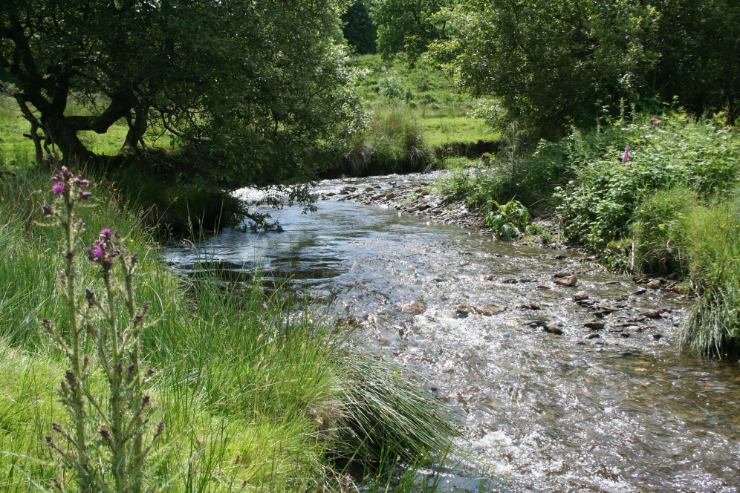
Enquiry 1: Ask questions
What are the river landforms?
What river processes are operating?
How is the surrounding land used by people?
How do human activities affect the river processes and landforms?
Does the river flood?
What are the characteristics of the river meander?

Slide 7
Enquiry 2: Collecting data
Remember that for one of your two investigations, one of your data collection methods must be that nominated by WJEC from Table A
The second investigation must be underpinned by the nominated conceptual framework (Table B)
You can use additional methods of data collection as you wish
Remember that fieldwork is an excellent way to practice geographical skills

Slide 8
Enquiry 2: River methodologies
Use of transects (across a feature) (2020 exam) | Change over time (comparing primary data with secondary sources) | Qualitative surveys (analysing perception) (2019 exam) | Geographical flows (analysing flows and patterns of movement) (2018 exam)
Determine patterns of flow and deposition across a river channel (measure river cross sections using tape and metre rule; measuring velocity at intervals) Investigate the river features and processes across a river channel (e.g. a meander) (measure and record the features of a meander) Investigate variations in bedload across a river channel (e.g. compare straight with meander or across a slip-off slope) (measure and record pebble characteristics at regular intervals across the river – maybe also velocity and depth) | Consider changing river landforms based on comparison of current evidence with historical evidence from maps/photos possibly making use of data collected during previous years (measure and record – sketches/ photos – current landforms and use secondary data to identify changes over time) Investigate changes in the sinuosity of a river, using maps to compare past and present patterns (draw a sketch map of a river stretch to calculate sinuosity and compare with historic maps) | Investigate the value of distinctive river landscapes (i.e. using environmental quality assessment) (use a bi-polar EIA, annotated sketches or photos or a questionnaire to assess values and perceptions) Investigate perceptions of flood risk (use a questionnaire/interviews to assess perception) | Infiltration rates in various soils or interception rates in various vegetation types within a catchment area (measure infiltration rates using , for example a water-filled metal cylinder) Discharge rates compared to rainfall or longitudinal survey of downstream changes in a river (with links to velocity) (measure velocity and cross sectional area to calculate discharge)

Slide 9
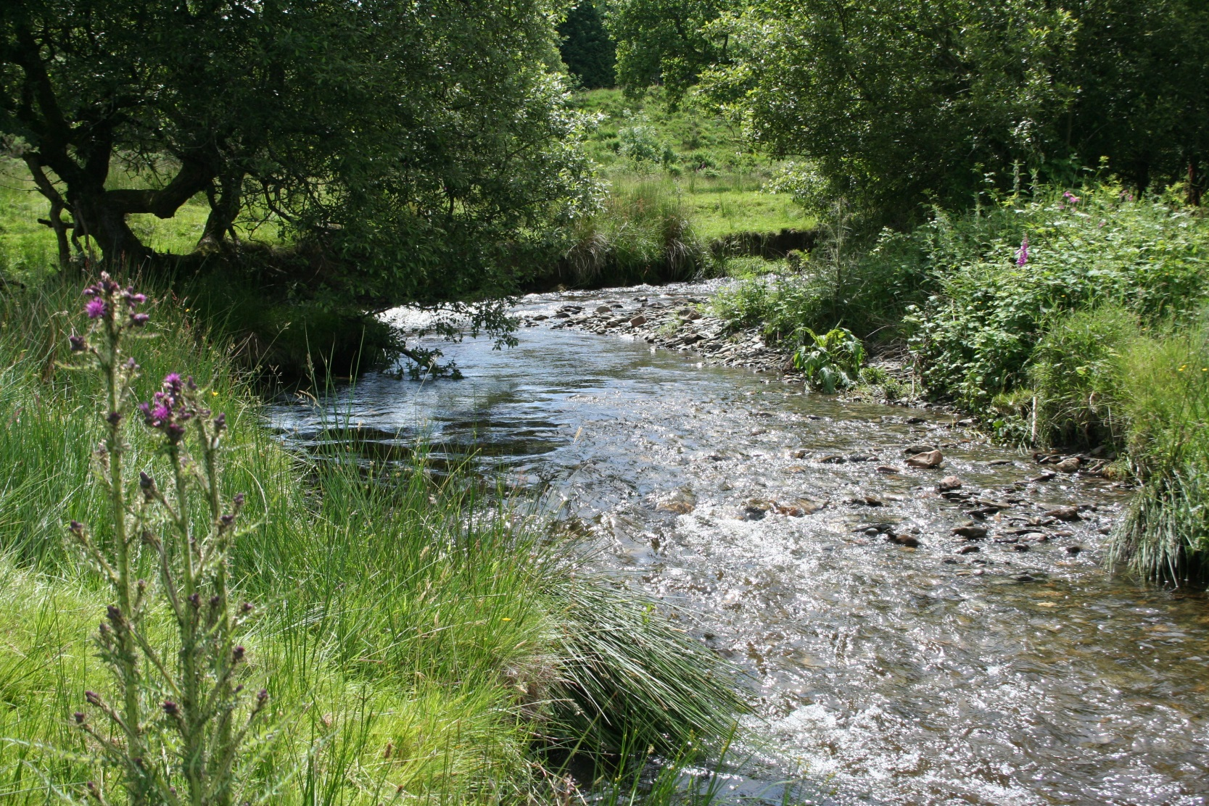
Enquiry 2: Afon Leri
Consider what methodologies could be used here to collect data

Slide 10
Enquiry 2: Collecting data
Design appropriate fieldwork data collecting sheets
Select appropriate locations (safety – risk assessment - ease of access, geographically sound)
Select appropriate sampling techniques (random, systematic, stratified)
Ensure accuracy and reliability
Remember that students will need to justify methodologies

Slide 11
Enquiry 3: Processing and presenting
Processing data
This involves making calculations from the data sheet and could involve:
Calculating central tendency (mean, mode, median), e.g. pebble sizes, velocity
Calculating proportions, e.g. percentages of pebble angularities
Calculating areas or flows, e.g. cross sectional area or discharge

Slide 12
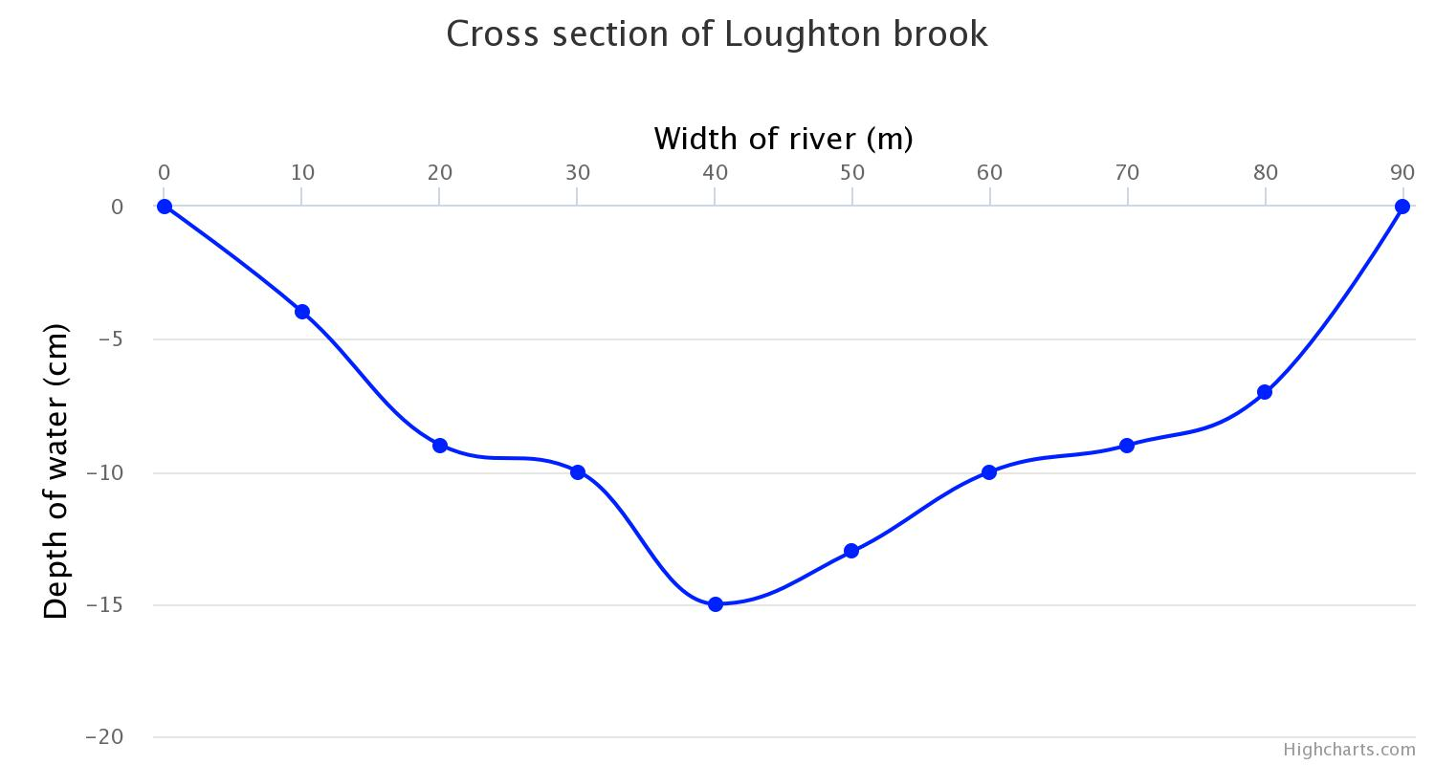
Enquiry 3: Processing and presenting
Presenting data
This involves selecting appropriate methods to present data and could include:
Cross sections, e.g. river channel, river valley, meander bend
X2 vertical exaggeration
Notes:
Please re-word title of diagram:
Cross-section of Loughton Brook
I have added a small text book in the diagram

Slide 13
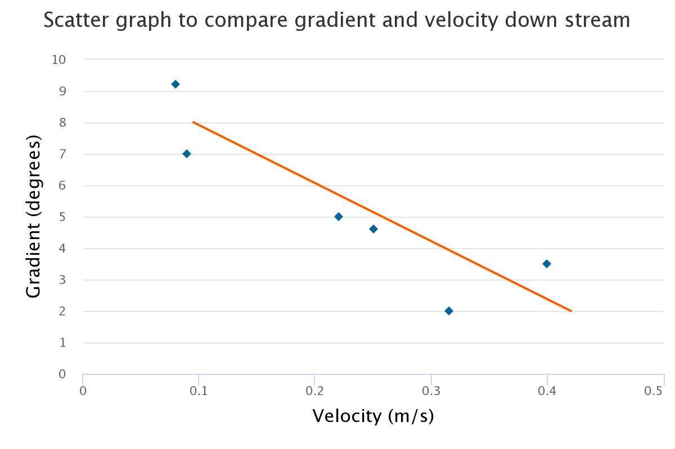
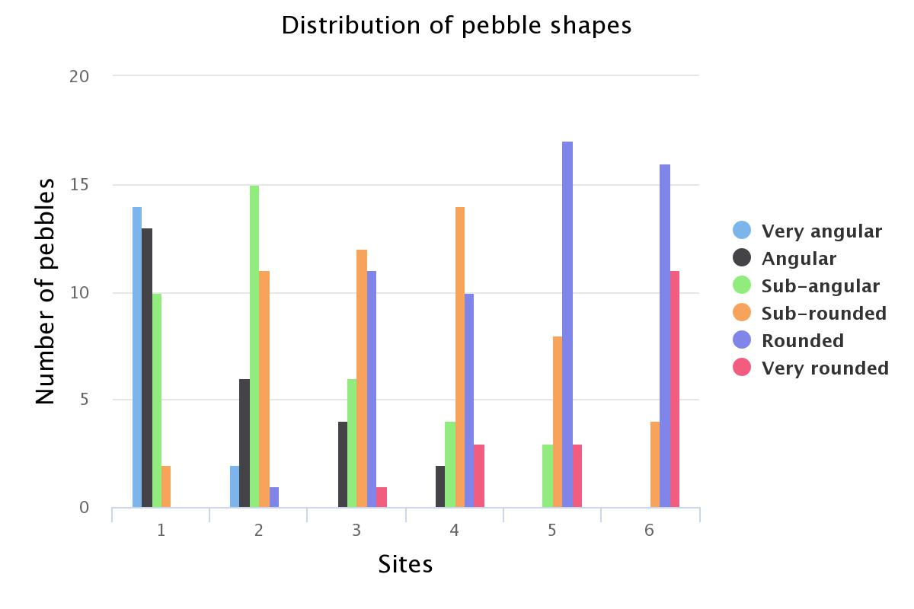
Enquiry 3: Processing and presenting
Presenting data
This involves selecting appropriate methods to present data and could include:
Scatter graphs showing changes
downstream, e.g. velocity, pebble sizes
Histograms, e.g. pebble size
categories
Notes:
Right diagram key: ‘Very angular’ and ‘Sub-rounded’ need to be altered

Slide 14
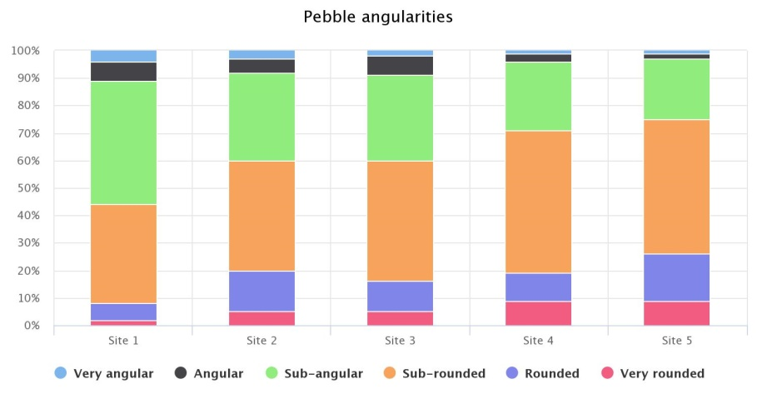
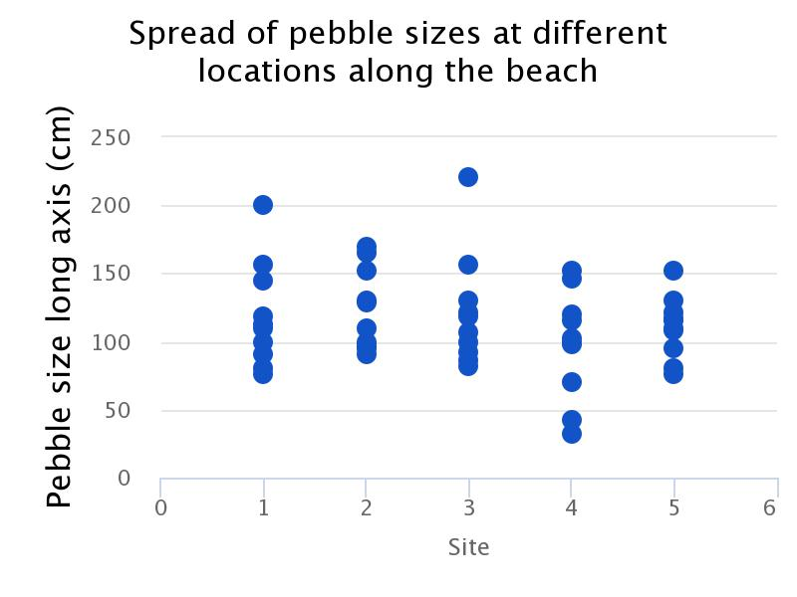
Enquiry 3: Processing and presenting
Presenting data
This involves selecting appropriate methods to present data and could include:
Pie charts/radar charts/divided bars
Dispersion graph
You could interpret a dispersion graph by marking the median, quartiles and range
Notes:
Hard to read the text embedded on the diagrams
To keep consistency – need hyphen in Sub-angular and Sub-rounded.

Slide 15
Enquiry 4: Analysing and wider understanding
Identify, analyse and interpret trends and patterns
Apply knowledge and understanding of geographical concepts and processes to specific evidence collected
Trends – changes over time, distance, etc
Patterns – regular repeating distributions, e.g. linear, radial, circular

Slide 16
Enquiry 4: Describing data
When describing trends and patterns consider using the acronym ‘GCSE’:
GC – general comment, describing the ‘big picture’, the overall trends and patterns
S – refer to specific information/data on the graphs, maps and diagrams to support your comments
E – identify and comment on any exceptions (anomalies) to the overall trend/pattern

Slide 17
Enquiry 4: Analysing data
The divided bar graphs indicate that pebbles are becoming less angular (more rounded) with distance downstream.
The proportion of pebbles in the very rounded, rounded and sub-rounded categories increases from 40% at Site 1 to 75% at Site 5.
Site 3 values deviate from the trend with a marginal increase in angularity (the three rounded categories drop from 60% at Site 2 to about 58% at Site 3). This could be the result of student error in data collection or possibly the input of fresh material from the river channel banks or valley sides.
The overall trend of decreasing angularity is to be expected according to the Bradshaw Model. Water transport results in attrition chipping off sharp edges and abrasion smoothing the pebbles. This explains the decrease in angularity with distance downstream.
Pebbles becoming more rounded,
less angular
Notes:
Sub-angular and Sub-rounded in the key

Slide 18
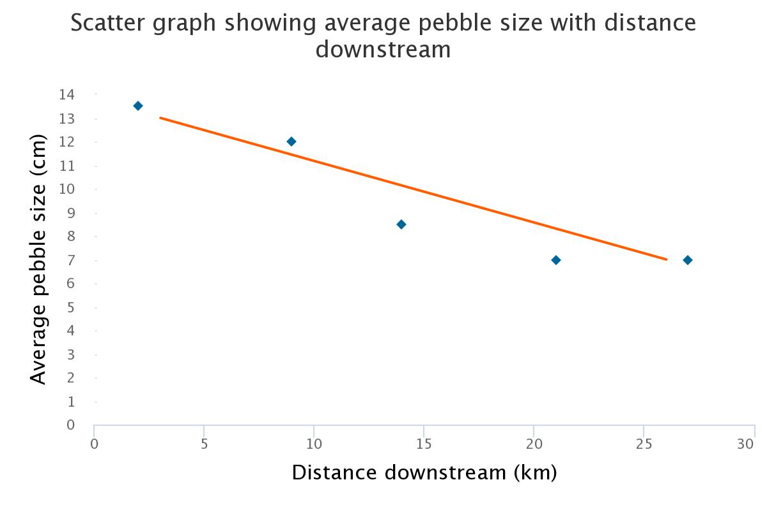
Enquiry 5: Drawing conclusions
This involves synthesising (pulling together) findings to reach evidenced conclusions that relate to the initial aim of the enquiry. Here’s an example:
‘In conclusion, my results clearly show that there are changes in the river’s bedload with distance downstream. The average pebble size decreased from 13.3cm at Site 1 to 6.5cm at Site 5 and pebble angularity decreased (sub-angular 45% at Site 1 to 23% at Site 5). This supports the Bradshaw Model and can be explained by the erosive action of water (attrition and abrasion) being increasingly effective as pebbles are transported downstream.’

Slide 19
Enquiry 5: Drawing conclusions
Expected trends and models are not always reflected in the real world, for example:
River flow (velocity) varies enormously – most fieldwork is conducted during low flow yet most landforms are formed at high flow. Patterns of velocity are often very different at low flow.
Pebbles enter a river along its course, so downstream changes in size and angularity may not be clearly evident
Human factors such as farming practices, channel modification and bridge construction can affect patterns of velocity, river channel shapes and bedload

Slide 20
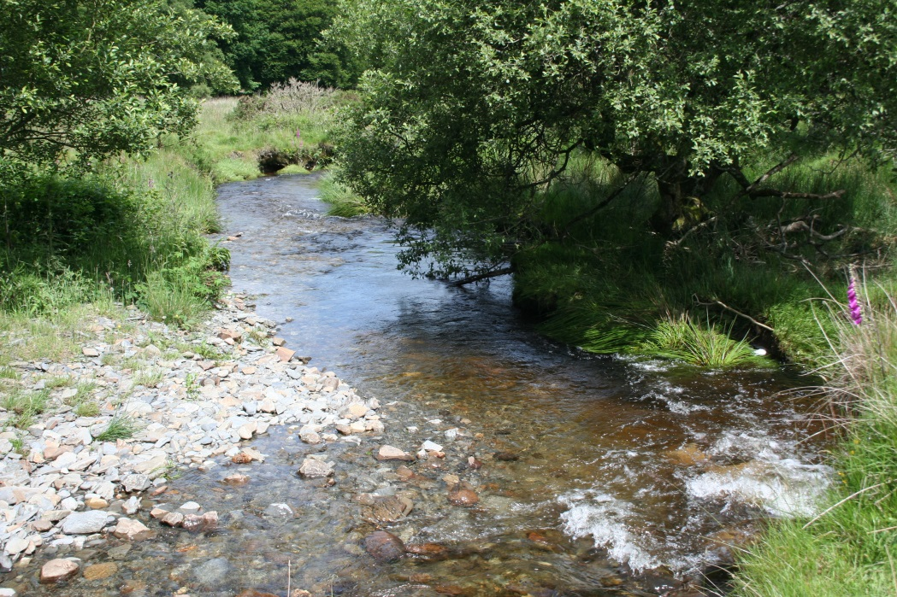
Enquiry 5: Drawing conclusions
At low flow, patterns of velocity may not be as expected
Farm animals flatten river banks to drink from the river
Flood management may modify channel shape
At low flow riffles have faster flow than pools, whereas the opposite is true at high flow
Notes:
Arrow heads to touch the box please

Slide 21
Enquiry 6: Evaluating the process
Identify the limitations of geographical evidence - accuracy, reliability and bias
Reflect critically on the strengths and limitations of both primary and secondary data, methods used, conclusions drawn and knowledge gained
Appreciate that stakeholders may have vested interests, introducing bias.

Slide 22
Enquiry 6: Evaluating the process
How might your results be different on another day or at a different time (high flow as opposed to low flow)?
How might an increase in the sample size or the number of sites have improved reliability?
With practice, might data collection techniques have been more accurate?
Was the sampling strategy appropriate?
Could inaccurate diagram construction have affected your conclusions?

