Slide 1
Applied Fieldwork Enquiry
Rural Settlement
Notes:
Rural Settlement – larger point size please

Slide 2
Table A: fieldwork methodologies
Fieldwork locality | Use of transects (across a feature) | Change over time (comparing primary data with secondary sources) | Qualitative surveys (analysing perception) | Geographical flows (analysing flows and patterns of movement)
Rural settlement | Investigate land use changes (or economic land values, environmental change, etc) across a village Investigate pollution away from a motorway (or similar) using indicators such as noise, air quality and lichens | Consider changing land use over time in a rural environment using maps and photos for historic comparisons Investigate changing functions in a village (e.g. suburbanisation) using past maps and census data Investigate to what extent a village is growing or declining | Investigate environmental quality of rural environments Investigate the sense of place of a village; what makes it special Investigate the impact of second homes or holiday homes in a village Consider the advantages and disadvantages of rural living | Analyse commuter movements in a dormitory settlement Investigate traffic management problems/solutions in a village

Slide 3
Table B: conceptual frameworks
Geographical theme | Place Applying understanding of uniqueness / identity | Sphere of influence Applying understanding of sphere of influence / catchment and how it impacts on places | Cycles and flows Applying understanding of change and movement in relation to place | Mitigating risk Applying understanding of hazard perception / risk and analysing management strategies / future actions | Sustainability Applying understanding of sustainable communities | Inequality Applying understanding of inequality and associated concepts such as deprivation or equality of access to services
Rural/village | Comparing two villages (environmental quality, sense of place, growth and decline, etc) | Identifying the sphere of influence of a village (tourism, historic/ cultural attractions, etc) and assessing its impacts on the hinterland | Migration survey which focuses on push-pull factors and their impacts in rural locations Study of commuter flows between an urban and neighbouring rural location Investigating traffic management issues in a village Investigating the impacts of newcomers (e.g. commuters, migrants) on the socio-economic characteristics of a village | Studying rural land use and its impact on infiltration / interception/flood risk Investigating environmental risk and its management for example, location of a new wind farm Investigating the socio-economic risks associated with a declining village | Investigating the effectiveness of an existing or planned community to meet requirements of Egan’s wheel Investigating the extent to which a village is embracing sustainable principles (e.g. energy, transport, recycling, etc) | Investigating how positive and negative externalities impact on standard of living in urban or rural environments Comparing access to services in rural and urban communities within the hinterland of one large urban area Evaluating quality of life for a named socio-economic group (for example, young families) in one community

Slide 4
WJEC nominated criteria
Table A: Methodologies
2018: Geographical flows
2019: Qualitative surveys
2020: Use of transects
Table B: Conceptual framework
2018: Cycles and flows
2019: Place
2020: Sphere of Influence

Slide 5

The six stages of the enquiry process
Ask questions
Collect data
Process & present data
Draw conclusions
Evaluate the process
Analysis and application of wider understanding

Slide 6
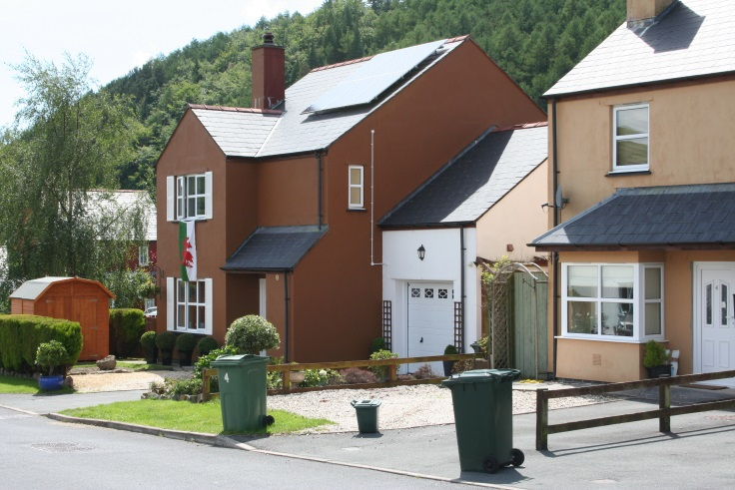
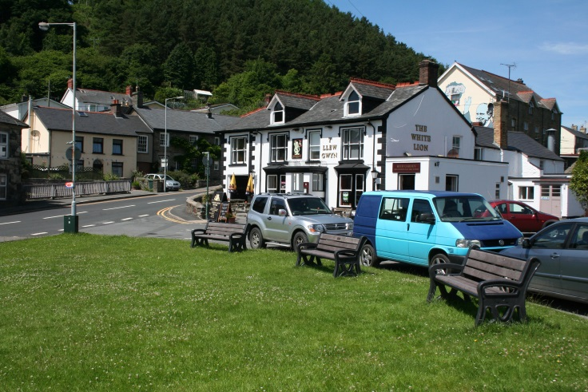
Enquiry 1: Ask questions
Has the function of the village changed over time?
Why are new houses being built here?
Is there a problem of flooding in the village?
What economic activities take place in the village?
Is the village economically sustainable?
How is traffic managed in the village?

Slide 7
Enquiry 2: Collecting data
Remember that for one of your two investigations, one of your data collection methods must be that nominated by WJEC from Table A
The second investigation must be underpinned by the nominated conceptual framework (Table B)
You can use additional methods of data collection as you wish
Remember that fieldwork is an excellent way to practice geographical skills

Slide 8
Enquiry 2: Rural settlement methodologies
Fieldwork locality | Use of transects (across a feature) (2020 exam) | Change over time (comparing primary data with secondary sources) | Qualitative surveys (analysing perception) (2019 exam) | Geographical flows (analysing flows and patterns of movement) (2018 exam)
Rural settlement | Investigate land use changes (or economic land values, environmental change, etc) across a village (plot land uses on a base map or transect line) Investigate pollution away from a motorway (or similar) using indicators such as noise, air quality and lichens (use air pollution instruments, mobile phone apps or lichen identification chart) | Consider changing land use over time in a rural environment using maps and photos for historic comparisons (compare modern land use maps/photos with historic) Investigate changing functions in a village (e.g. suburbanisation) using past maps and census data (use old maps and census) Investigate to what extent a village is growing or declining (use observations, photos, questionnaires) | Investigate environmental quality of rural environments Investigate the sense of place of a village; what makes it special Investigate the impact of second homes or holiday homes in a village Consider the advantages and disadvantages of rural living (use EIAs, bi-polar charts, questionnaires, sketches and photos) | Analyse commuter movements in a dormitory settlement (conduct traffic counts, questionnaires) Investigate traffic management problems/ solutions in a village (plot traffic management, questionnaires, local council information)

Slide 9
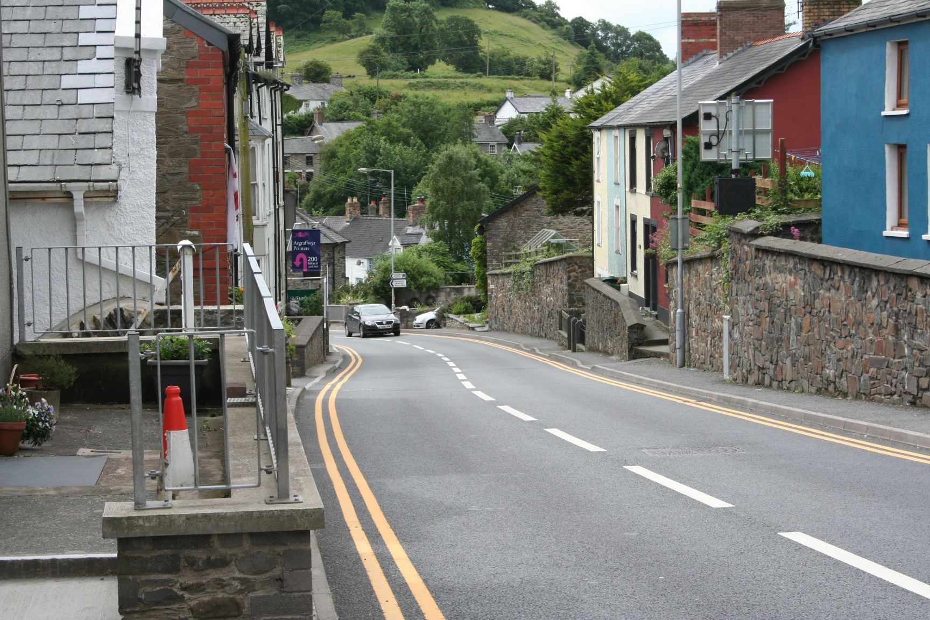
Enquiry 2: Tal-y-Bont
Consider what methodologies could be used here to collect data

Slide 10
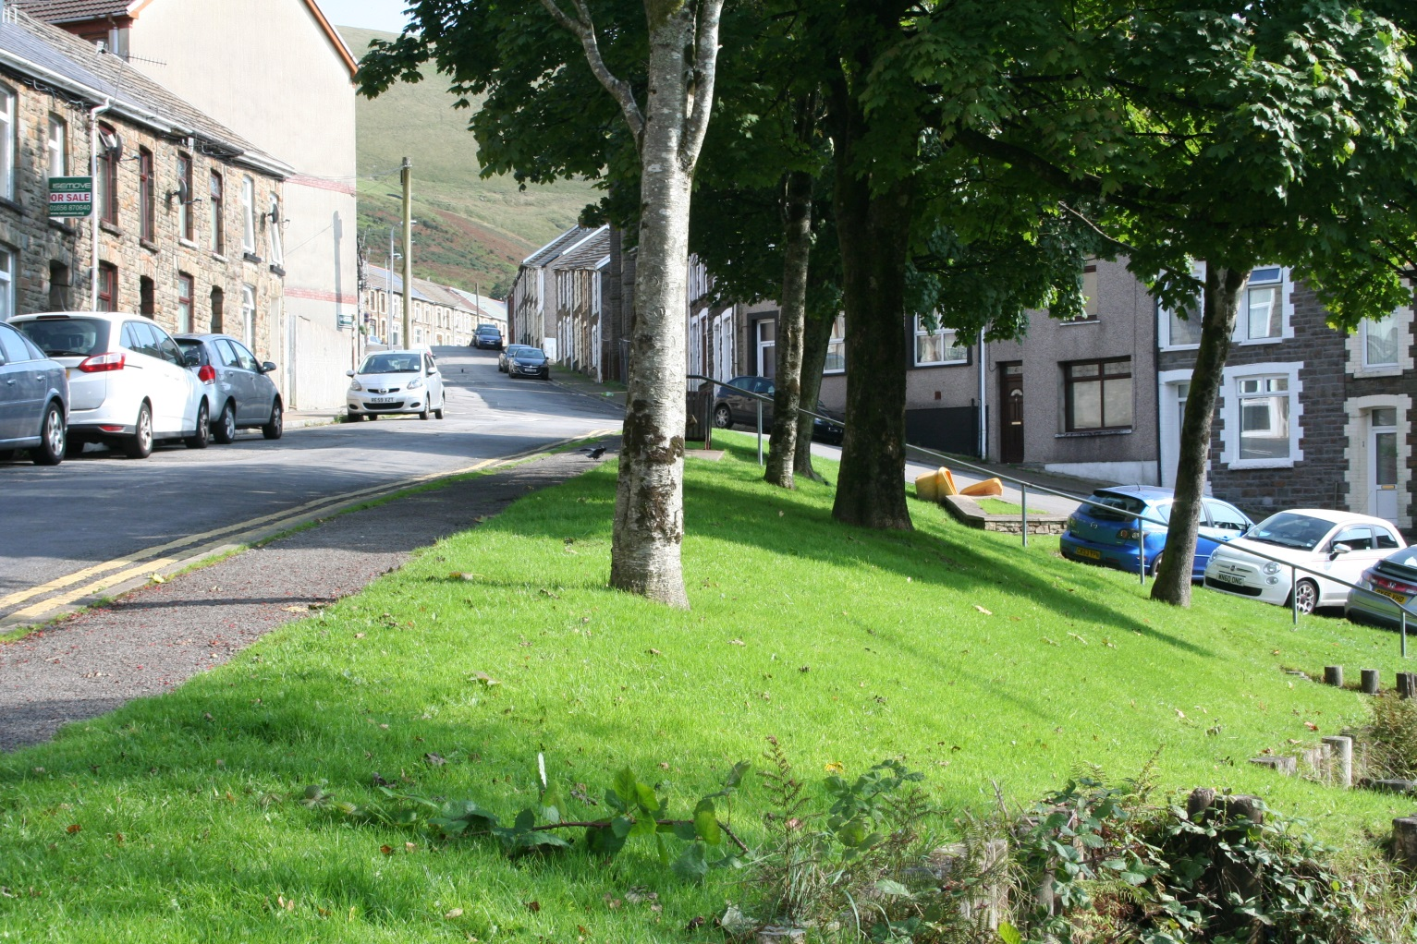
Enquiry 2: Blaengarw
Consider what methodologies could be used here to collect data

Slide 11
Enquiry 2: Collecting data
Design appropriate fieldwork data collecting sheets
Select appropriate locations (safety – risk assessment - ease of access, geographically sound)
Select appropriate sampling techniques (random, systematic, stratified)
Ensure accuracy and reliability
Remember that students will need to justify methodologies

Slide 12
Enquiry 3: Processing and presenting
Processing data
This involves making calculations from the data sheet and could involve:
Calculating averages (e.g. traffic or pedestrians)
Converting data into percentages or degrees for the drawing of pie charts
Comparative statistical measures (e.g. percentage change or difference between places)

Slide 13
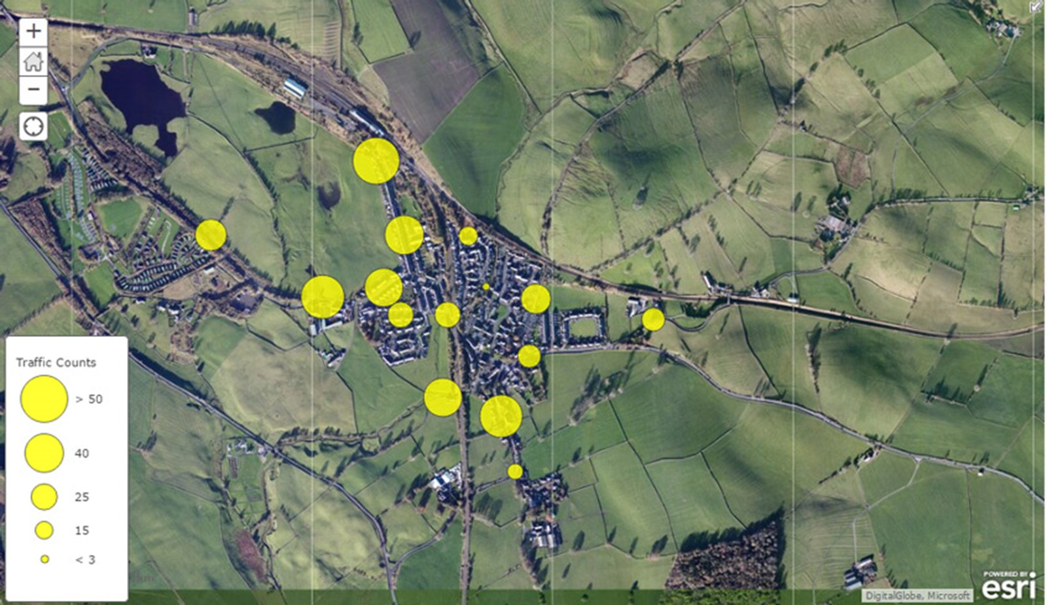
Enquiry 3: Processing and presenting
Presenting data
This involves selecting appropriate methods to present data and could include:
Use GIS to plot traffic counts as proportional circles

Slide 14
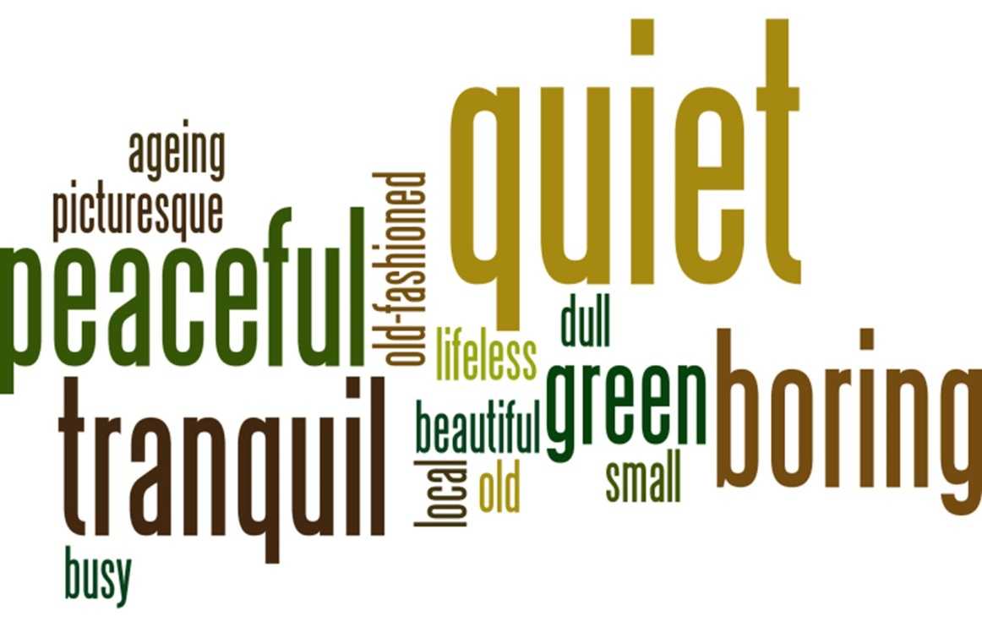
Enquiry 3: Processing and presenting
Presenting data
This involves selecting appropriate methods to present data and could include:
Use a word cloud program such as Wordle to present qualitative data
Notes:
Do we need the weblink reference here? It’s not on the other diagrams.

Slide 15
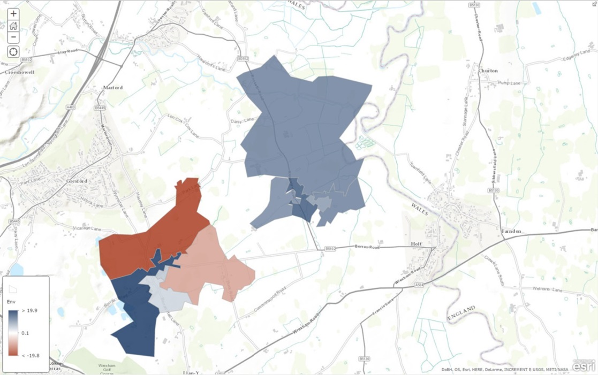
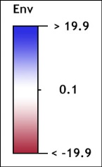
Enquiry 3: Processing and presenting
Presenting data
This involves selecting appropriate methods to present data and could include:
Use GIS to plot environmental assessment as a choropleth map
Notes:
The key cannot be read – please could it be enlarged/re-drawn?

Slide 16
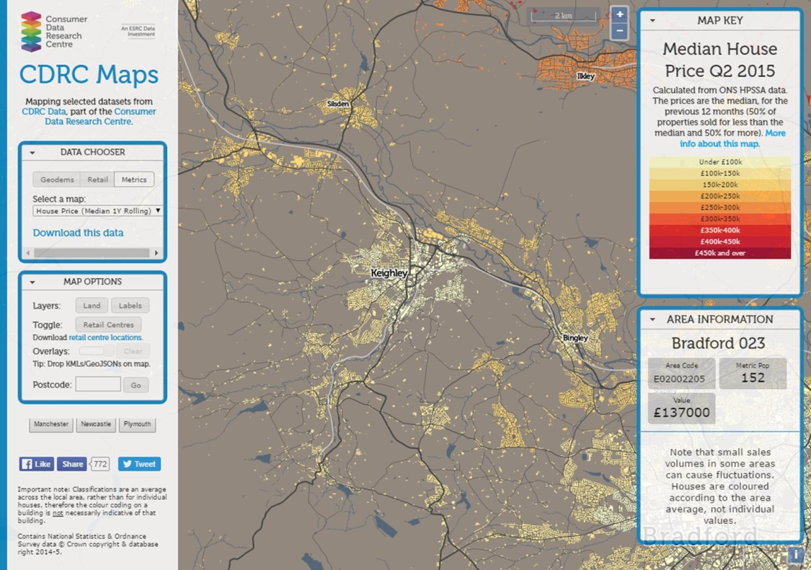
Enquiry 3: Processing and presenting
Presenting data
This involves selecting appropriate methods to present data and could include:
Secondary data (e.g. Consumer Data Research Centre) could be annotated with text and photos

Slide 17

Annotated photo showing characteristics of Tal-y-Bont
Houses upgraded – relatively new roofing and newly painted
Attractive hilly landscape on the edge of the village
Light traffic passing through the centre of the village
Traffic management – double yellow lines to restrict parking on the main road
Pavement on one side of the road – fairly narrow

Slide 18
Enquiry 4: Analysing and wider understanding
Identify, analyse and interpret trends and patterns
Apply knowledge and understanding of geographical concepts and processes to specific evidence collected
Trends – changes over time, distance, etc.
Patterns – regular repeating distributions, e.g. linear, radial, circular

Slide 19
Enquiry 4: Describing data
When describing trends and patterns consider using the acronym ‘GCSE’:
GC – general comment, describing the ‘big picture’, the overall trends and patterns
S – refer to specific information/data on the graphs, maps and diagrams to support your comments
E – identify and comment on any exceptions (anomalies) to the overall trend/pattern

Slide 20

Enquiry 4: Analysing data
The word cloud suggests that the village has a number of characteristics typically associated with rural settlements, such as ‘quiet’, ‘peaceful’ and ‘tranquil’. These are characteristics that are attractive to some people.
As well as the more positive words, there are some negative words such as ‘boring’, ‘dull’ and ‘lifeless’. These words may apply to different parts of the village or simply reflect different people’s opinion.
The presence of ‘busy’ and ‘quiet’ appear contradictory but they might apply to different parts of the village.

Slide 21

Enquiry 5: Drawing conclusions
This involves synthesising (pulling together) findings to reach evidenced conclusions that relate to the initial aim of the enquiry. Here’s an example:
‘In conclusion, my results suggest that the village has undergone considerable change over the last hundred years or so. Throughout much of the 20th century mining dominated the landscape and the village provided homes, shops and entertainment for the mine workers and their families.
As the mines closed down in the second half of the 20th century, decline set in. The population fell, shops closed and properties became derelict. Several buildings have changed use. Today, the village is a commuter settlement and it is thriving. Several new houses have been built, the shops and pubs are well used and the village has a high environmental quality.’

Slide 22
Enquiry 5: Drawing conclusions
Expected trends and models are not always reflected in the real world, for example:
The method of data collection (e.g. transect) can be biased and unrepresentative giving a distorted set of results
Questionnaires conducted at a certain time of day may not be representative of the population as a whole
The time of day/week will affect flows of traffic and people
EIAs can be adversely affected by the weather conditions
Villages may not fit a single type or trend – they are often multi-functional and show signs of both decline and prosperity

Slide 23

Enquiry 5: Drawing conclusions
Weather conditions will affect the outcome of qualitative studies and people’s behaviour in the village
Time of year will affect the behaviour of residents and the number of visitors to the village
Traffic may vary greatly during the day – this may not be picked up by a traffic survey
Insufficient or biased responses to questionnaires may distort the results and conclusion

Slide 24
Enquiry 6: Evaluating the process
Identify the limitations of geographical evidence - accuracy, reliability and bias
Reflect critically on the strengths and limitations of both primary and secondary data, methods used, conclusions drawn and knowledge gained
Appreciate that stakeholders may have vested interests, introducing bias.

Slide 25
Enquiry 6: Evaluating the process
How might your results be different on another day or at a different time of year?
How might an increase in the sample size or the number of sites have improved reliability?
With practice, might data collection techniques have been more accurate?
Was the sampling strategy appropriate?
Could inaccurate diagram construction have affected your conclusions?

