Slide 1
Applied Fieldwork Enquiry
Urban
Notes:
Urban – larger point size?

Slide 2
Table A: fieldwork methodologies
Fieldwork locality | Use of transects (across a feature) | Change over time (comparing primary data with secondary sources) | Qualitative surveys (analysing perception) | Geographical flows (analysing flows and patterns of movement)
Urban | Assess quality of life or environmental quality across an urban area Study land use changes across a city Investigate the edge of the CBD/central area Investigate pollution away from a motorway (or similar) using indicators such as noise, air quality and lichens Investigate the vegetation succession in an urban wasteland ecosystem Investigate the impacts of international migration | Changing land use over time in an urban environment (for example brownfield site), using maps and other data for historic comparisons Changing patterns of retailing – compare current retail patterns to historic data from a previous year Investigate the impacts of pedestrianisation or redevelopment in a town using historic maps/data Investigate the impacts of international migration, comparing present day with historic data | Investigate environmental quality of urban environments Investigate the impacts of an urban green space (or urban wasteland ecosystem) on the local community Investigate the sense of place of an urban area Investigate the effects of a football ground (or similar) on the local environment Investigate the impacts of pedestrianisation or redevelopment in a town Investigate crime and vandalism in a town or city Investigate the impacts of international migration | Investigate commuter movements in a town Investigate traffic or pedestrian flows, for example relating pedestrian flows in a retail environment to parking provision in an urban area or identifying the best route for a cycle path Investigate the impacts of international migration

Slide 3
Table B: conceptual frameworks
Geographical theme | Place Applying understanding of uniqueness / identity | Sphere of influence Applying understanding of sphere of influence /catchment and how it impacts on places | Cycles and flows Applying understanding of change and movement in relation to place | Mitigating risk Applying understanding of hazard perception / risk and analysing management strategies / future actions | Sustainability Applying understanding of sustainable communities | Inequality Applying understanding of inequality and associated concepts such as deprivation or equality of access to services
Urban | Comparing two urban environments (environmental quality, sense of place, impacts of international migration, etc) Comparing the quality of life in two neighbourhoods | Identifying the sphere of influence of an urban area (retailing, employment, entertainment, green space, etc) and assessing its impacts on the hinterland | Migration survey which focuses on push-pull factors and their impacts in urban locations Investigating diurnal flows within urban environments and the effects for example, on transport systems, the environment, etc Study of commuter flows between an urban and neighbouring rural location | Study urban land use and its impact on infiltration / interception/flood risk Investigating air quality in an urban area, its impact and management options Investigating people’s perceptions of crime and risk in a town | Investigating the impacts of a pedestrianisation scheme or park and ride scheme Investigating the effectiveness of an existing or planned community to meet requirements of Egan’s wheel Investigating sustainable ways to manage the journey to school for example, the best route for a new cycle route to school Investigating possible sustainable uses of a brownfield site (link with urban wasteland ecosystem) | Investigating how positive and negative externalities impact on standard of living in urban or rural environments Comparing access to services in rural and urban communities within the hinterland of one large urban area Evaluating quality of life for a named socio-economic group (for example, young families) in one community Assessing quality of the urban environment and its impact on house prices across an urban transect Evaluating the success of an urban regeneration scheme in reducing deprivation

Slide 4
WJEC nominated criteria
Table A: Methodologies
2018: Geographical flows
2019: Qualitative surveys
2020: Use of transects
Table B: Conceptual framework
2018: Cycles and flows
2019: Place
2020: Sphere of Influence

Slide 5

The six stages of the enquiry process
Ask questions
Collect data
Process & present data
Draw conclusions
Evaluate the process
Analysis and application of wider understanding

Slide 6
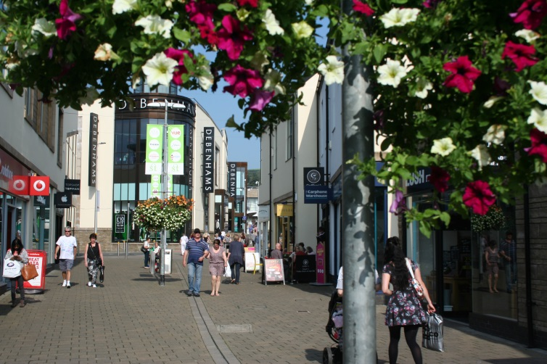
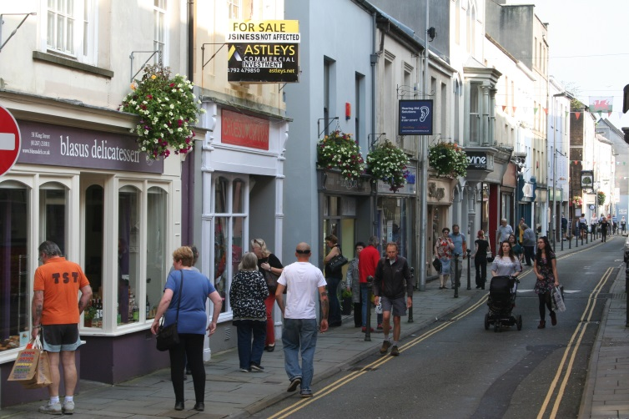
Enquiry 1: Ask questions
What effect has the new shopping development had on the town?
Does environmental quality vary in the town?
Is there a change in land use with distance from the town centre?
How is traffic managed in the town?
How has pedestrianisation affected the development of the town?
IMG 8530
IMG 8502

Slide 7
Enquiry 2: Collecting data
Remember that for one of your two investigations, one of your data collection methods must be that nominated by WJEC from Table A
The second investigation must be underpinned by the nominated conceptual framework (Table B)
You can use additional methods of data collection as you wish
Remember that fieldwork is an excellent way to practice geographical skills

Slide 8
Enquiry 2: Urban methodologies
Fieldwork locality | Use of transects (across a feature) (2020 exam) | Change over time (comparing primary data with secondary sources) | Qualitative surveys (analysing perception) (2019 exam) | Geographical flows (analysing flows and patterns of movement) (2018 exam)
Urban | Assess quality of life or environmental quality across an urban area (complete an EIA and use annotated photos or field sketches) Study land use changes across a city (plot land uses on a base map) Investigate the edge of the CBD/central area (consider changes in land use, building height, pedestrians) Investigate pollution away from a motorway (or similar) using indicators such as noise, air quality and lichens (use instruments or lichen indicator chart) Investigate the vegetation succession in an urban wasteland ecosystem (use quadrats and observation chart) Investigate the impacts of international migration (use questionnaires and observe land uses) | Changing land use over time in an urban environment (for example brownfield site), using maps and other data for historic comparisons (plot land use and compare with historic maps/photos) Changing patterns of retailing – comparing current retail patterns to historic data from a previous year (record current shopping patterns and compare with secondary data) Investigate the impacts of pedestrianisation or redevelopment in a town using historic maps/data (conduct questionnaires, use photos to compare with historic) Investigate the impacts of international migration, comparing present day with historic data (use of old maps, census data, photos and questionnaires) | Investigate environmental quality of urban environments Investigate the impacts of an urban green space (or urban wasteland ecosystem) on the local community Investigate the sense of place of an urban area Investigate the effects of a football ground (or similar) on the local environment Investigate the impacts of pedestrianisation or redevelopment in a town Investigate crime and vandalism in a town or city Investigate the impacts of international migration (use of qualitative measures such as EIAs, questionnaires, bi-polar charts and photos together with GIS data) | Investigate commuter movements in a town (record traffic flows) Investigate traffic or pedestrian flows, for example relating pedestrian flows in a retail environment to parking provision in an urban area or identifying best route for a cycle path (record traffic flows, conduct questionnaires) Investigate the impacts of international migration (use questionnaires and observe land uses)

Slide 9
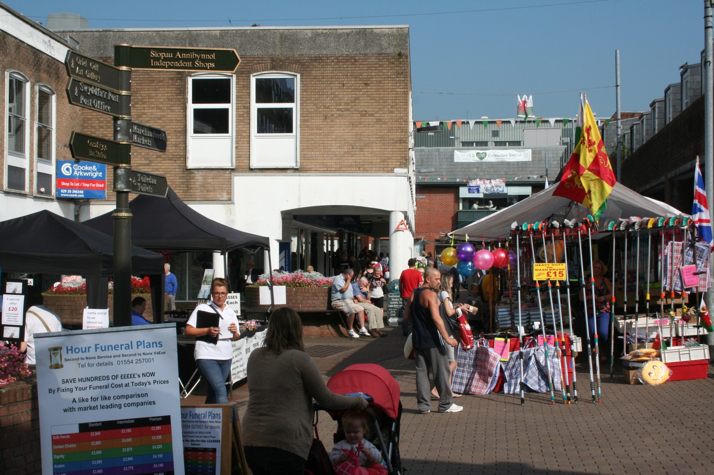
Enquiry 2: Carmarthen
Consider what methodologies could be used here to collect data

Slide 10
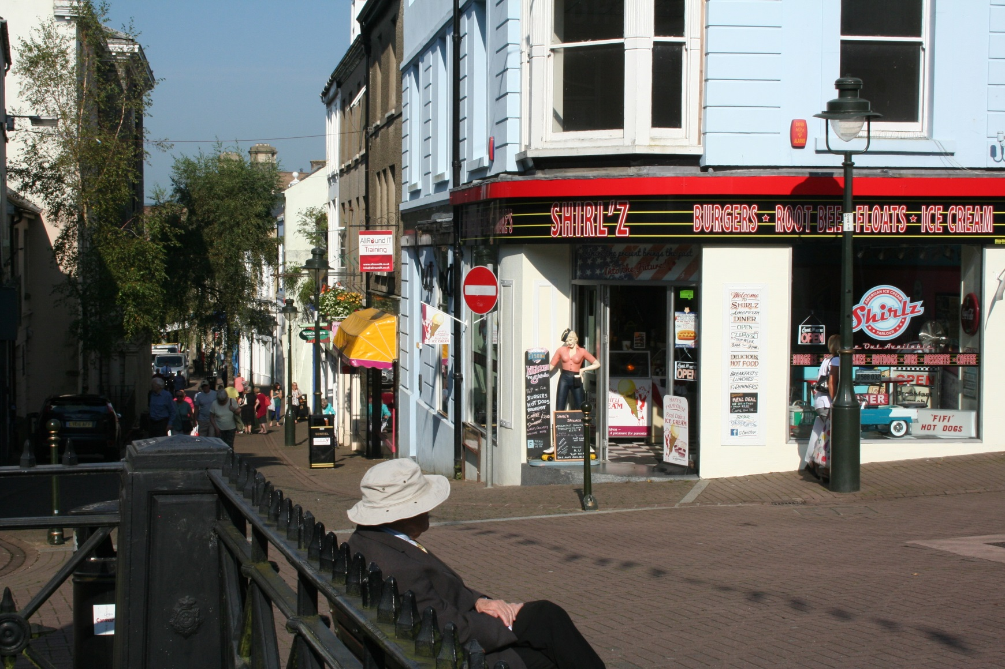
Enquiry 2: Carmarthen
Consider what methodologies could be used here to collect data

Slide 11
Enquiry 2: Collecting data
Design appropriate fieldwork data collecting sheets
Select appropriate locations (safety – risk assessment - ease of access, geographically sound)
Select appropriate sampling techniques (random, systematic, stratified)
Ensure accuracy and reliability
Remember that students will need to justify methodologies

Slide 12
Enquiry 3: Processing and presenting
Processing data
This involves making calculations from the data sheet and could involve:
Calculating flow rates of traffic or pedestrians
Calculating EIA scores
Converting data into percentages (e.g. lichen indicators, vegetation quadrats, questionnaires)
Comparative statistical measures (e.g. percentage change) for census or crime data

Slide 13
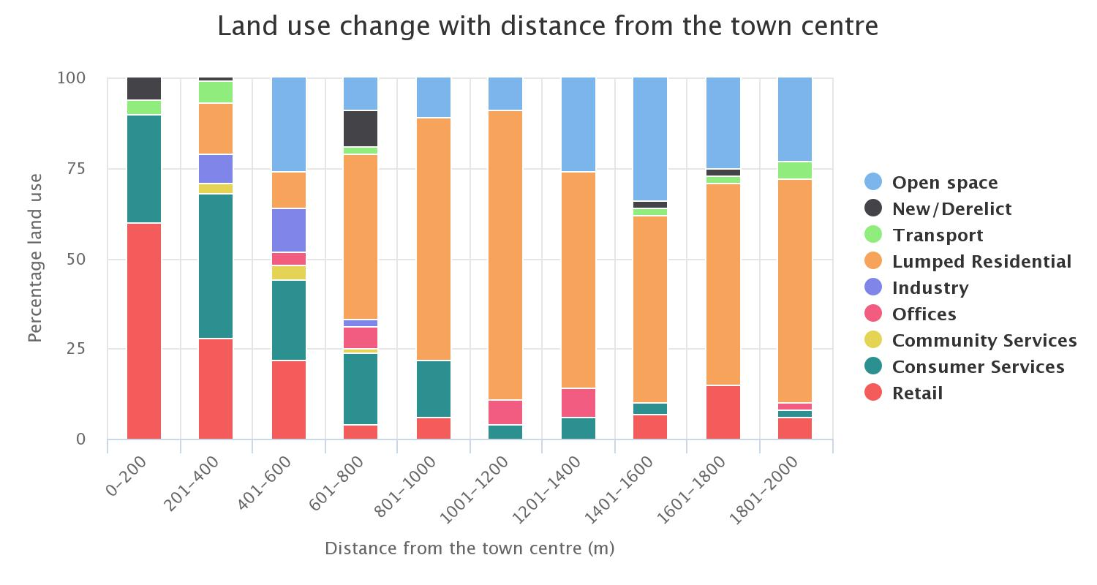
Enquiry 3: Processing and presenting
Presenting data
This involves selecting appropriate methods to present data and could include:
Composite (divided) bar graphs, e.g. showing land use change
Notes:
Key
Residential (no need for ‘lumped’)

Slide 14
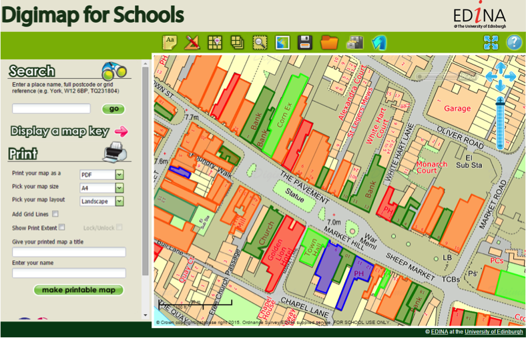
Enquiry 3: Processing and presenting
Presenting data
This involves selecting appropriate methods to present data and could include:
Use GIS to plot land uses onto a base map

Slide 15
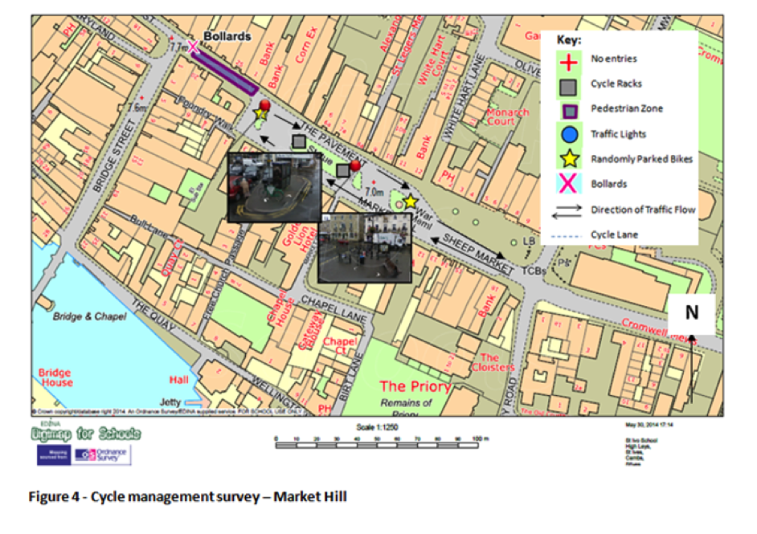
Enquiry 3: Processing and presenting
Presenting data
This involves selecting appropriate methods to present data and could include:
Use GIS to plot cycle management onto a base map
Notes:
Diagram title should read:
Cycle management survey – Market Hill
No need for ‘Figure 4’

Slide 16
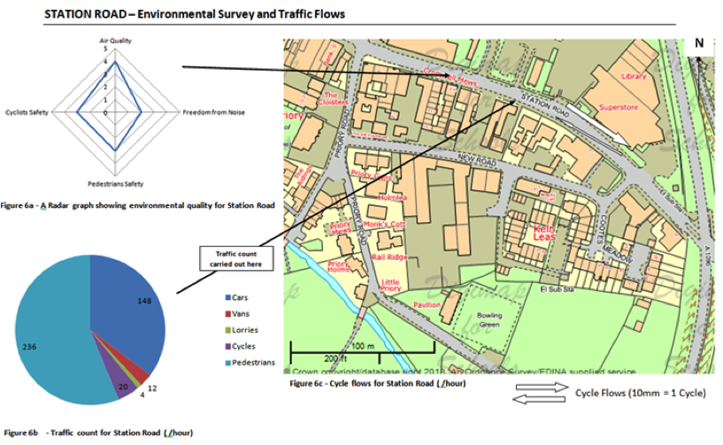
Enquiry 3: Processing and presenting
Presenting data
This involves selecting appropriate methods to present data and could include:
Radar graph, pie chart and flow map
Notes:
Please remove Figure 6a, b and c from the headings below each of the separate diagrams
Writing in box is not easy to read. Needs to be sharper and less blurred.

Slide 17
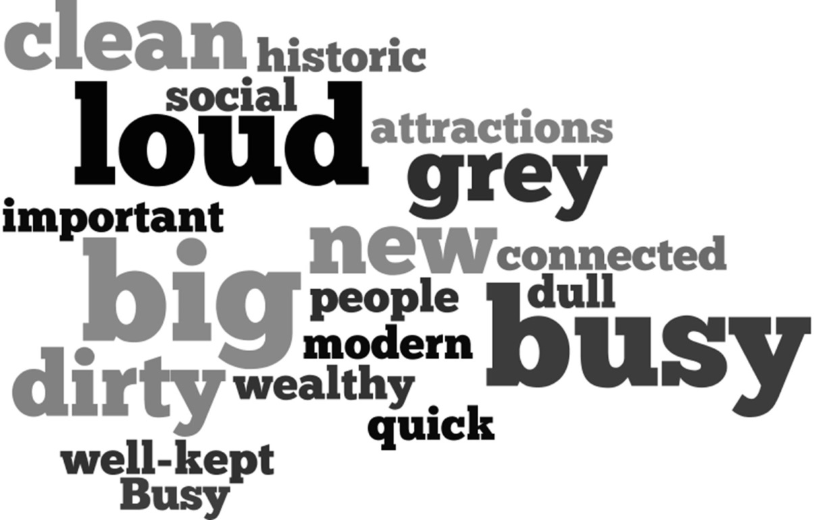
Enquiry 3: Processing and presenting
Presenting data
This involves selecting appropriate methods to present data and could include:
Use a program such as Wordle to present qualitative data
https://www.geography-fieldwork.org/gcse/urban/cbd/data-presentation/
Notes:
Do we need the website links here?

Slide 18

Annotated photo showing a traditional shopping street in Carmarthen
Hanging baskets to improve environmental quality
Double yellow lines indicate traffic management
Older traditional shopping street, with relatively small independent shops
One-way street
Shopping street popular with a range of ages
Notes:
I’d prefer the photo in the centre with labels around the outside if possible – thanks.
Bottom left text – I have changed ‘age’ to ‘ages’

Slide 19
Enquiry 4: Analysing and wider understanding
Identify, analyse and interpret trends and patterns
Apply knowledge and understanding of geographical concepts and processes to specific evidence collected
Trends – changes over time, distance, etc.
Patterns – regular repeating distributions, e.g. linear, radial, circular

Slide 20
Enquiry 4: Describing data
When describing trends and patterns consider using the acronym ‘GCSE’:
GC – general comment, describing the ‘big picture’, the overall trends and patterns
S – refer to specific information/data on the graphs, maps and diagrams to support your comments
E – identify and comment on any exceptions (anomalies) to the overall trend/pattern

Slide 21
Enquiry 4: Analysing data
The divided bar graph shows that there is a significant change in land use with distance from the town centre.
Close to the town centre there is a dominance of retailing (58%) and consumer services (35%). The percentage of these two land uses decreases significantly to about 14% at 8001-1000 metres from the town centre.
The dominance of retailing and consumer services close to the town centre reflects the historic development of the town around its central most accessible point.
Residential land use increases towards the edge of the town to reach a maximum of about 80% at 1001-1200 metres from the town centre. Here land was available for building and was not too expensive.
Notes:
Diagram overlapping text
See Slide 13 for slight change to key
Overlapping text at 4th bullet point?

Slide 22

Enquiry 5: Drawing conclusions
This involves synthesising (pulling together) findings to reach evidenced conclusions that relate to the initial aim of the enquiry. Here’s an example:
‘In conclusion, my results clearly show that land use changes with distance from the town centre. The town centre is dominated by retailing and consumer services, which accounts for over 90% of the land use.
Both land uses decrease with distance from the town centre to be replaced by a dominance of residential, which increases significantly from 1000 metres. These changes reflect a number of factors such as accessibility, economic activity, historical development and political management decisions. It is not possible to directly relate the pattern of land use to the urban models, which tend to be over-simplified.’

Slide 23
Enquiry 5: Drawing conclusions
Expected trends and models are not always reflected in the real world, for example:
Land use models, such as the Burgess Model, are highly simplified and relate to American planned cities
Urban management has greatly altered the land use in towns, particularly the regeneration of town centres
Having developed largely unplanned for hundreds of years, towns in the UK often have mixed land uses with no obvious patterns
Multi-storey buildings often have several land uses (retail, office and residential) – land use maps tend to focus on ground floor only, giving a rather inaccurate impression

Slide 24
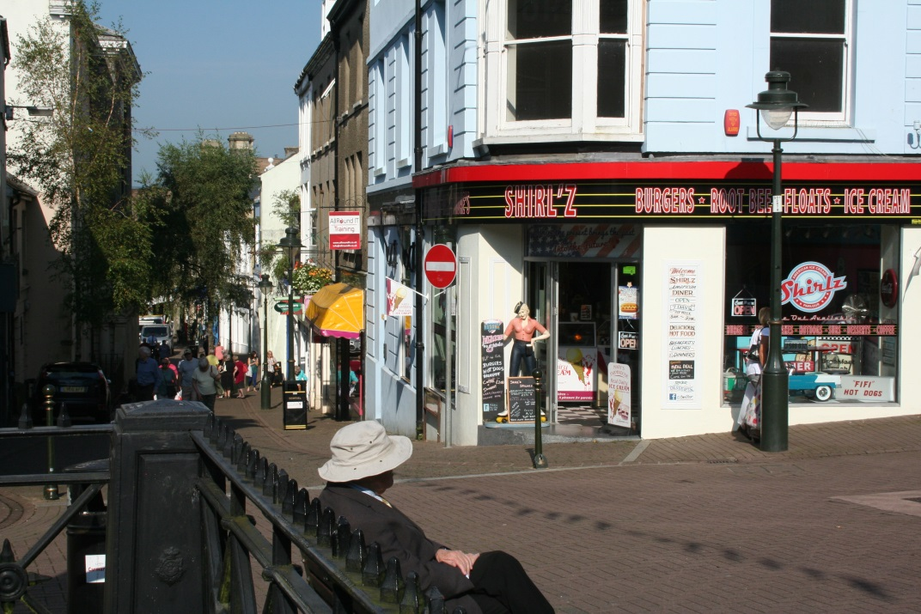
Enquiry 5: Drawing conclusions
Access may be limited to parts of the town due to road works or urban regeneration
Weather conditions, time of day and time of year will affect people’s behaviour and may give unexpected results
Infrequent events, such as festivals may give unexpected and unrepresentative results
Some towns were severely damaged in WW2, wiping out historical patterns
Notes:
Arrows to touch box please
Would prefer central photo with arrows/text boxes around the edges with some symmetry.

Slide 25
Enquiry 6: Evaluating the process
Identify the limitations of geographical evidence - accuracy, reliability and bias
Reflect critically on the strengths and limitations of both primary and secondary data, methods used, conclusions drawn and knowledge gained
Appreciate that stakeholders may have vested interests, introducing bias.

Slide 26
Enquiry 6: Evaluating the process
How might your results be different on another day or at a different time of year (local people or tourists)?
How might an increase in the sample size or the number of sites have improved reliability?
With practice, might data collection techniques have been more accurate?
Was the sampling strategy appropriate?
Could inaccurate diagram construction have affected your conclusions?

